Slide 1
International Copper Association Panel Discussion — Future Market Share

Slide 2
Antitrust Guidelines for Copper Industry Trade Association Meetings
The following guidelines with respect to compliance with antitrust laws of the United States, Japan and European Community¹ are intended to govern the conduct of participants in copper industry trade association meetings, both at the meeting itself and in informal discussions before or after the formal meeting.
Price: Competitors should not discuss future prices (including terms of sale) of their products. There is no blanket prohibition against the mention of or reference to current or past prices but limits must be observed. Such references or mentions should occur only when necessary in connection with the development of association programs. For example, reference to a particular price level in comparing the cost of a copper product to a competing product is permitted. Whenever possible, such references should be discussed in advance with legal counsel.
Competitive Information: Competitors should not discuss the market share of a particular copper producer or copper fabricator’s products. Furthermore, nothing should be said at a meeting which could be interpreted as suggesting prearranged market shares for such products or producer production levels. The overall market share of copper products may be discussed with regard to competition with non-copper products and general market acceptance.
New Products: Competitors should not encourage or discourage the introduction of a new product by another competitor or reveal a particular copper company’s plans to change the production rate of an existing product or to introduce a new product. No company should disclose to another company whether it is in a position to make or market a new product. New products may be discussed in a technical manner or from the standpoints of competition with non-copper products and general market acceptance. In addition, proposed methods for and results of field and laboratory testing can be considered.
The Role of Legal Counsel: Legal counsel attends association meetings to advise association staff and other meeting attendees regarding the antitrust laws and to see that none of the matters discussed or materials distributed raise even the appearance of antitrust improprieties. During the course of a meeting, if counsel believes that the discussion is turning to a sensitive or inappropriate subject, counsel will express that belief and request that the attendees return the discussion to a less sensitive area.
A paper entitled ‘Copper Industry Trade Associations and Antitrust Laws’ is available upon request.
10/92, 5/93, 10/10
1. Other foreign competition laws apply to International Copper Association, Ltd. ICA’s activities worldwide.
Notes:
TO CHANGE

Slide 3
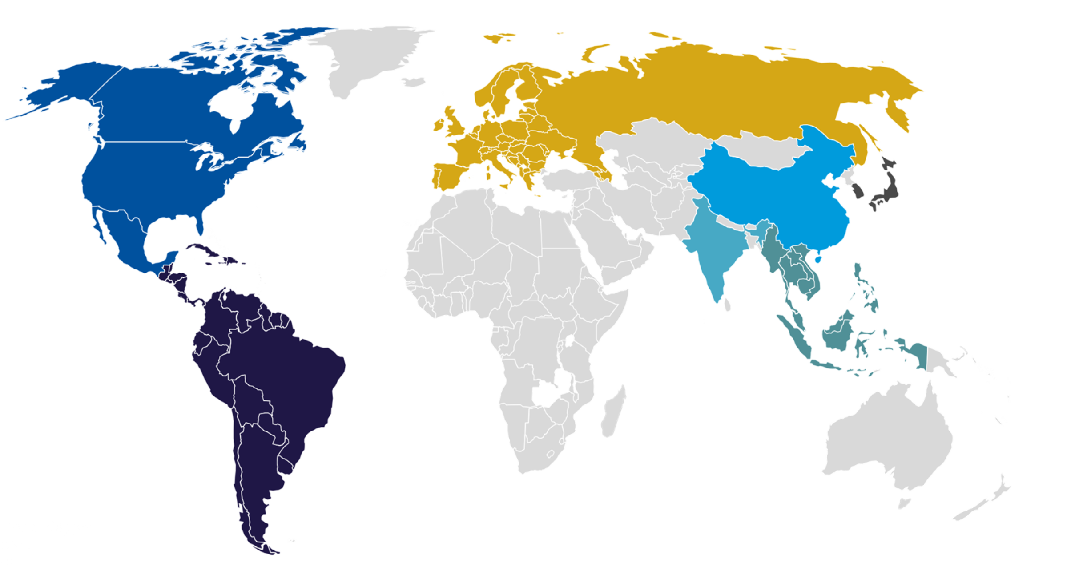
Regional macro trends expected to shape global long-term copper demand
China
Europe
Reduced copper demand expected due to:
Slower future economic growth over the next three decades than the previous 20 years.
Economic growth changing from being investment-led to consumer-led, which is less copper intensive.
Copper use to increase due to:
A focus on energy security, including initiatives to ensure 45 percent of Europe’s energy is generated from renewable sources, in line with climate objectives.
Rising Battery Electric Vehicle (BEV) market.
Europe
Northeast Asia
North America
Copper use could decline due to:
Changing demographics resulting in lower consumer demand.
However, demand is expected to increase due to:
Floating onshore wind becoming a key renewable energy asset and growth market.
North America
Long-term copper demand to increase due to:
Reshoring and expansion of domestic manufacturing.
India
Continued rise in copper use since 2022 due to:
Expected tenfold economic growth by 2050 driven by a rapidly expanding and urbanizing population.
A growing industrial sector and renewable energy infrastructure.
South & Central America
Refined copper use to increase due to:
New renewable energy capacity.
Expansion in Brazil’s automotive industry.
ASEAN
ASEAN
ASEAN region is benefiting from ubanisation, population growth and becoming a global manufacturing hub. Copper demand from the region is expected to increase by an order of three by 2040. Automotive production represents a significant end use application of copper cable in this region
Copper demand expected to increase threefold by 2040 due to:
Urbanization, population growth and becoming a global manufacturing hub.
Automotive production representing a significant end use application of copper cable in this region.
Source: CRU

Slide 4
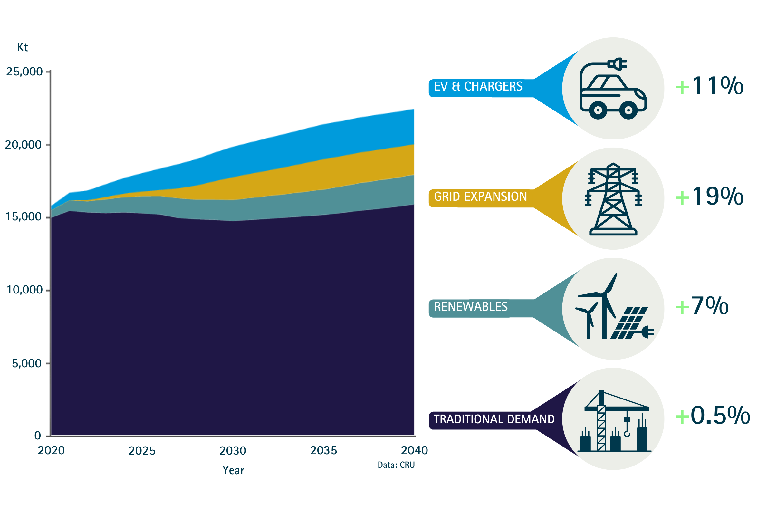
Wire and cable copper demand forecast to be driven by the Green Energy Transition (GET)
The green energy transition in China, Europe and North America is expected to increase total copper demand, offsetting the slow-down in growth from traditional demand.
As renewable energy systems are more copper intensive, CRU research estimates that renewable energy could contribute up to 5.6 million tonnes (Mt) to total copper demand from 2020 – 2040.
Overall wire and cable demand from the green energy transition is expected to increase from 0.8 Mt to 6.7 Mt between 2020 – 2040 at a compound annual growth rate (CAGR) of 11 percent.
Sales of copper-intensive Electric Vehicles (EVs) are expected to reach 70 million by 2040, with 85 percent of total sales coming from New Energy Vehicles (NEVs).
However, technological developments in the automotive industry is forecast to translate into decreasing copper intensity for EVs.
Wire and cable global GET vs traditional demand 2020-2040, kt
Source: CRU

Slide 5
Driven mainly by energy infrastructure, wire rod copper demand is forecast to be over 25 Mt by 2040
Wire rod demand by region, 2020-2040, kt
As the most important portion of copper demand in the long-term, the wire rod segment is projected to remain at 60 – 62 percent of total copper demand.
Research conducted by CRU states that wire rod demand is forecast to increase at a CAGR of 1.8 percent, in line with total copper demand. Total wire rod tonnage could increase by approximately 7.5 Mt globally.
China is expected to remain the largest consumer of copper wire rod.
India and ASEAN are expected to see the highest rates of growth, followed by the Americas.
Most of the growth in this sector is forecast to be driven by the buildout of energy infrastructure, with construction serving as a secondary driver.
Source: CRU

Slide 6
A forecast 3 percent loss in copper market share is expected to be offset by increases in total copper use in the long term
Wire and cable copper demand 2020-2040, kt
Wire and cable copper and aluminium market share, by main cable type in 2020 vs. 2040, %
Copper share:
2020
2040
- 3%
-1%
-10%
-5%
-2%
Source: CRU

Slide 7
Net copper substitution only 1.36 percent in 2023
In 2023, net substitution accounted for 1.45 percent of copper use —1.8 percent of copper use including miniaturization.
Results of this study are based on the aggregated subjective opinions of market participants.
Source: DMM Advisory Group

