Slide 1


Copper Social Sustainability Potential

Slide 2
Antitrust Guidelines for Copper Industry Trade Association Meetings
The following guidelines with respect to compliance with antitrust laws of the United States, Japan and European Community¹ are intended to govern the conduct of participants in copper industry trade association meetings, both at the meeting itself and in informal discussions before or after the formal meeting.
Price: Competitors should not discuss future prices (including terms of sale) of their products. There is no blanket prohibition against the mention of or reference to current or past prices but limits must be observed. Such references or mentions should occur only when necessary in connection with the development of association programs. For example, reference to a particular price level in comparing the cost of a copper product to a competing product is permitted. Whenever possible, such references should be discussed in advance with legal counsel.
Competitive Information: Competitors should not discuss the market share of a particular copper producer or copper fabricator’s products. Furthermore, nothing should be said at a meeting which could be interpreted as suggesting prearranged market shares for such products or producer production levels. The overall market share of copper products may be discussed with regard to competition with non-copper products and general market acceptance.
New Products: Competitors should not encourage or discourage the introduction of a new product by another competitor or reveal a particular copper company’s plans to change the production rate of an existing product or to introduce a new product. No company should disclose to another company whether it is in a position to make or market a new product. New products may be discussed in a technical manner or from the standpoints of competition with non-copper products and general market acceptance. In addition, proposed methods for and results of field and laboratory testing can be considered.
The Role of Legal Counsel: Legal counsel attends association meetings to advise association staff and other meeting attendees regarding the antitrust laws and to see that none of the matters discussed or materials distributed raise even the appearance of antitrust improprieties. During the course of a meeting, if counsel believes that the discussion is turning to a sensitive or inappropriate subject, counsel will express that belief and request that the attendees return the discussion to a less sensitive area.
A paper entitled ‘Copper Industry Trade Associations and Antitrust Laws’ is available upon request.
10/92, 5/93, 10/10
1. Other foreign competition laws apply to International Copper Association, Ltd. (ICA)’s activities worldwide.

Slide 3
This study aims to assess the socio-economic impact of the copper mining sector in areas of influence
Introduction
We have followed a methodological approach to assess the global impact of the sector
Context of the copper mining sector
Socio-economic impact assessment
Enabling socio-economic policies & practices
Socio-economic impact extrapolation

Slide 4

Context of the copper mining sector
1.

Slide 5






While organic growth will remain, global copper demand is expected to be driven by energy transition-related sectors especially EVs and Grids
Copper Social Sustainability Potential
Copper consumption in the transport sector is expected to accelerate through to 2040
Copper demand growth by sector (in Mt)
Copper consumption by industry sector
Under Wood Mackenzie’s Accelerated Energy Transition 1.5-Degree Scenario (WM AET-1.5)
Historical
Forecast
Mt
CAGR (%)
50
’22-40
1.7
0.3
45
+0.6
0.2
40
0.5
0.6
1.9
35
+5.0
30
+1.0
25
20
+2.2
15
10
+2.0
5
0
2010
2015
2020
2025
2030
2035
2040
2020
Organic Demand
Wind
Solar
ESS
Other
Power
EVs
ICEs
EVs
Chargers
Grids
2050
Construction
Industrial Machinery
Consumer & general
Electrical Network
Transport
Source: Wood Mackenzie analysis

Slide 6






Copper mine production is dominated by Latin America, with the region accounting for ~39% of global supply in 2022 as it holds most reserves
Copper Social Sustainability Potential
The total primary copper production is expected to grow at ~1.3% per year through 2040
Global copper reserves, top-ranked countries, 2022
Copper mine production by region
Historical
Forecast
Mt
+1.3%
39 Mt
40
35
30
47 Mt
25
20
15
85 Mt
31 Mt
10
5
0
199 Mt
22 Mt
2010
2015
2020
2025
2030
2035
2040
Middle East
Oceania
Africa
North America
Europe
Russia
Asia
Latin America
Source: Wood Mackenzie analysis

Slide 7
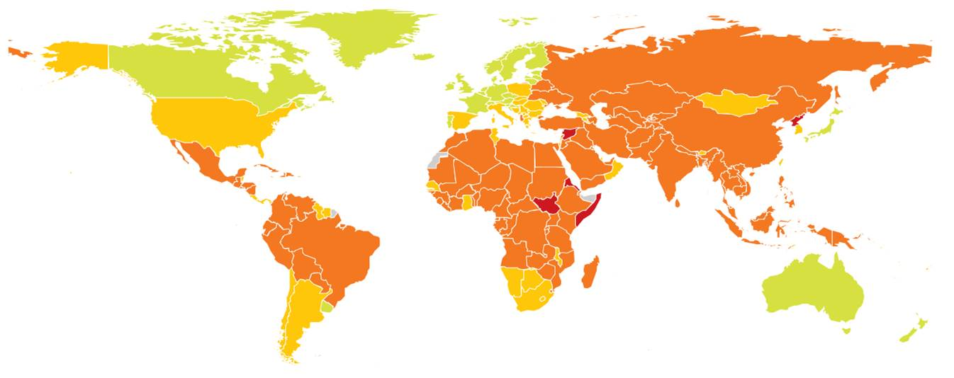
Meeting future copper supply requirements will entail investment in countries that exhibit significant ESG risk with long lead times
Copper Social Sustainability Potential
Few mining jurisdictions offer low ESG risk opportunities
Key ESG factors impacting the copper mining industry
Environmental:
Biodiversity disruption
Deforestation
Water stress
Climate change
Social:
Indigenous people
Human rights
Child labour
Freedom of association
Governance:
Democratic governance
Public corruption
Property rights
Judicial independence
Low
High
ESG Risk
Source: Wood Mackenzie Analysis. Verisk Maplecroft, 2022
Notes:
So what do we have so far:
We are going to need a lot more metals to decarbonise the economy in any scenario
The investment just isn’t there at the moment
Even if the investment comes quickly, long lead times are still a challenge
So I think that answers the question that constraints in metals supply could impede the energy transition.
But here is one more consideration:
Here you will recognise a map of the political world. And the colours represent the ESG risk as defined by our sister company Verisk Maplecroft. We all know what ESG is but on the slide you have some of the factors that make up the index. Red means high ESG risk, green is lower risk.
And you can see, places like the DRC – which has lots of cobalt – places like Bolivia and Peru – which have lithium, copper – places like Indonesia – which has nickel – all rank as places with high ESG risk. So the places that we are going to look to first to deliver these metals required for the energy transition, have trade offs.
We are switching out the geopolitics of oil and gas and OPEC, for the above ground risk of child labour in the DRC, resource nationalism, deforestation etc.
So this is another risk to future metals supply. And a challenge that investors must navigate. If they do so – the rewards are clear.

Slide 8


In the process, the copper mining industry generates significant socio-economic value with a long-lasting impact on our society
Copper Social Sustainability Potential
Impacts can be grouped in two categories: elevating livelihoods & distributing economic value
Key socio-economic impacts of copper mining
Elevating Livelihoods
Employment
Quality
Provide equal & safe employment
Create jobs which promote gender diversity, social inclusion, and best-in-class occupational health & safety
1
Household Income
Increase household income & benefits
Provide financial security & social stability to the workforce and their families, hence lifting the economic standing of the community
2
Capacity Building
Advance workforce’ skillset & careers
Develop the workforce’s knowledge & know-how, allowing to grow within the company and transfer those skills to other sectors
3
Distributing Economic Value
Institutional Reinforcement
Contribute to government revenues
Reinforce government’s stewardship over the country’s mineral resources, and the economic value their extraction generates
4
Industrial Diversification
Support the local industrial ecosystem
Leverage mining-related investments to catalyse the sustainable development and economic diversification of the region
5
Community Development
Sustain the community’s development
Establish a positive footprint on the community with lasting benefits on infrastructure, health, education and the economy
6
Source: Wood Mackenzie analysis

Slide 9

Socio-economic impact assessment
2.

Slide 10
We have taken a closer look at three operations to assess operational best practices and determine the socio-economic value distributed
Copper Social Sustainability Potential
We have established a screening methodology to narrow down the most relevant operations
Criteria 1
Is the asset part of a global company or a national champion?
2
724 assets
▼
524 assets
Criteria 2
Is the LOM > 15years with a production capacity > 150ktpa?
524 assets
▼
43 assets
3
1
Criteria 3
Is the company part of the International Copper Association?
43 assets
▼
3 assets
Other considerations:
Regional diversity
Data availability
Data segregation
…
# Copper Assets
100+
10
Source: Wood Mackenzie analysis

Slide 11




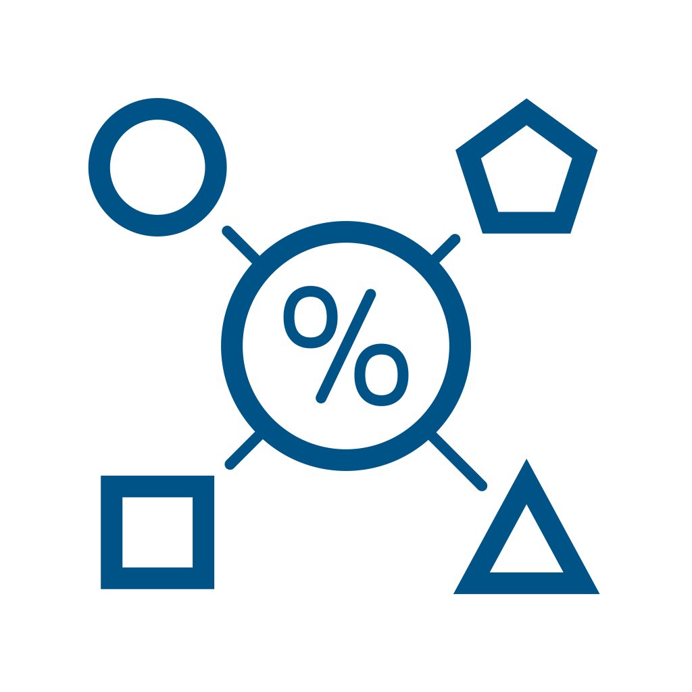





Our two-step assessment will aim to demonstrate the positive socio-economic trend and estimate the subsequent lifetime benefits
Copper Social Sustainability Potential
We will highlight success stories which could inspire replication across the sector
1
2
Establish positive socio-economic impact over time
Estimate lifetime socio-economic benefits
Socio-economic Impacts
Business
Disclosures
Selected Benchmarks
Infrastructure Development
Health Facilities
Educational Resources
Economic Diversification
Employment
Quality
Absolute
Metrics
Precise
measures of key parameters
Government
Household Income
Capacity Building
Institutional Reinforcement
Relative
Metrics
Calculated measures based on different figures
Industry
Railways
Ports
Airports
Roads
Hospitals
Clinics
Beds
Landfills
Doctors
Patients
Schools
Classrooms
Teachers
Students
Scholarships
Agriculture
Fishery
Textile
Carpentry
Industrial Diversification
Community Development
Source: Wood Mackenzie analysis

Slide 12
Operation 1 displays consistently growing indigenous employment figures with best-in-class safety records
Copper Social Sustainability Potential
Female employment is growing, but remains relatively low at ~7%
1
Employment Quality
Relevant metrics
+4%
Total number of direct employees
Proportion of female / indigenous / national / expatriate workforce
Cumulative safety training spend
Total recordable injury frequency (TRIF) rate
Total Direct Employees
% Female (RHS)
2,842
2,855
2,955
Indigenous
2,781
2,768
National & Expatriate
41%
42%
42%
40%
40%
59%
58%
58%
60%
60%
Key takeaways
2017
2018
2019
2020
2021
Direct employment has been consistently increasing (~4%)
40% of employees are indigenous to the specific region
The female workforce makes up 7%; relatively low but growing
Safety spend has been steadily increasing, totaling $3.7M
The TRIF is below industry average and has been steadily decreasing (~8%)
$M
-8%
4.0
3.7
3.5
Cumulative safety
training spend (RHS)
3.3
3.0
2.5
TRIF - Operation 1
TRIF
2.2
2.0
TRIF - Industry
1.3
1.3
1.5
0.7
1.0
0.5
2017
2018
2019
2020
2021
0.0
Source: Wood Mackenzie analysis, ICMM - Safety Performance Report 2021. Note: TRIF = Total Recordable Injury Frequency rate

Slide 13
Between 2017–2021, Operation 3 has contributed over $400M in wages & benefits, with the 2021 wage ~63% greater than the national level
Copper Social Sustainability Potential
Operation 3 was able to increase wages in 2020, despite the impact of COVID-19
2
Household Income
Relevant metrics
Employee Wage & Benefits ($M)
+13%
Employee wages & associated benefits spend
Average employee wage & associated benefits (calculated)
Average national wage
Minimum national wage
+64%
Annual
Cumulative
Key takeaways
2017
2018
2019
2020
2021
Employee wages & associated benefits have been consistently increasing (~13%)
The 2021 spend is 64% greater than the 2017 spend
The (calculated) average wage & associated benefits per employee is 63% greater than the national average wage, and significantly above the national minimum wage
+12%
Ave. Wage & Benefits ($K)
8.0
7.8
7.5
7.0
Operation 3 average
6.0
5.3
5.3
+63%
National average (2021)
5.0
4.6
Minimum wage (2021)
4.0
3.0
2.0
1.5
1.0
N/A
0.0
2017
2018
2019
2020
2021
Source: Wood Mackenzie analysis, The World Bank

Slide 14
Cumulatively, Operation 1 has invested over $13M in employee trainings over 2017-2021, or average of ~$913 per employee per year
Copper Social Sustainability Potential
COVID-19 has triggered a revision of the learning plan, with a shift to virtual delivery
1
Capacity Building
Relevant metrics
Allocated Training Budget ($M)
-4%
$
Total allocated training budget
Average allocated training budget per employee
Total training hours
Average training hours per employee (calculated)
Training budget
per employee (RHS)
Total allocated
training budget
Ø 913
Key takeaways
2017
2018
2019
2020
2021
An average of $900/year is being spent to train each employee
The training budget allocation has remained relatively stable despite the impact of COVID-19
Post-COVID, traditional learning plans have shifted from in-person to virtual, which optimized costs
Each employee spends an average of 53 hours in training per year
Total Training Hours (‘000)
500
-22%
Total training hours
400
Average training hours
per employee (RHS)
300
200
196
192
Ø 53
139
100
67
71
0
2017
2018
2019
2020
2021
Source: Wood Mackenzie analysis

Slide 15
Between 2017–2021, Operation 2 has contributed ~ $6B in payments to the government, predominantly as taxes and royalties
Copper Social Sustainability Potential
Corporate income taxes accounted for ~37% of government payments in 2021
3
Institutional Reinforcement
Relevant metrics
Total government payments (annual and cumulative)
Government payments breakdown (2017 vs. 2021)
Government Payments ($M)
Annual payments
+27%
Cumulative total
Ø 1,175
Key takeaways
2017
2018
2019
2020
2021
A total of ~$5.9B has been paid to the government over 5 years, or an average of $1.2B per year
Yearly payments have been steadily increasing (~27%)
Income tax in in 2021 represented 37% of government payments compared to 15% in 2017.
After income tax, the largest contributors are Royalties and Dividend payments, respectively
3%
Property Taxes
Employee Payroll Taxes
2017 Payment Breakdown
WHT on Foreign Dividends
2021 Payment Breakdown
Corporate Income Taxes
Dividends
Royalties and Severance Taxes
Other Taxes & Fees
Source: Wood Mackenzie analysis

Slide 16
Operation 3 has procured almost $4B worth of goods & services for its operations since 2017, the majority of which is sourced locally
Copper Social Sustainability Potential
Operation 3 procures from over 94 local suppliers and has spent ~$1.7M per year with each
2
Industrial Diversification
17%
Relevant metrics
Total procurement spend
Proportion of indigenous / national / foreign procurement spend
Number of indigenous suppliers
Average indigenous suppliers spend
Procurement of Goods ($M)
% Local (RHS)
National
1,158
Indigenous
885
894
Foreign
625
690
52%
50%
48%
54%
14%
16%
52%
19%
15%
36%
36%
17%
29%
Key takeaways
31%
31%
Total procurement spend has been steadily increasing (~17%)
The local procurement spend (national + indigenous) has remained relatively stable (~68%)
The number of indigenous suppliers has been consistently growing (from 83 to 94 in 2021)
An average of $1.7M has been spent on indigenous suppliers, a steadily growing figure (~15%)
2017
2018
2019
2020
2021
Procurement per supplier ($M)
4.0
15%
3.5
# Indigenous
suppliers (RHS)
3.0
Indigenous average
2.5
2.3
2.0
1.5
1.6
1.4
Ø 1.7
1.5
1.0
0.5
N/A
0.0
2017
2018
2019
2020
2021
Source: Wood Mackenzie analysis

Slide 17
Between 2017-2021, Operation 1 has invested ~$94M in the community across sectors, of which health, infrastructure, sanitation, education
Copper Social Sustainability Potential
Those investment commitments consistently translate into practical projects executions
1
Community Development
Relevant metrics
+2%
$M
Total community spend
Community spend breakdown
Community projects disbursement
Community projects execution
Community Investments ($M)
21
20
Health
19
10%
19
10%
Infrastructure
10%
10%
14%
59
15
14%
Sanitation
14%
17%
14%
17%
40
17%
12%
16%
Education
23%
14%
18%
23%
23%
16%
Irrigation
22%
Other
35%
35%
35%
33%
40%
Key takeaways
Cumulative Total (RHS)
2017
2018
2019
2020
2021
Community investments totaled ~$94M over the 5-year timeframe, and have remained relatively stable over that period
A total of 37 projects have been executed over that timeframe
Annual project disbursements have been consistently growing (~39%)
Annual Project Disbursement ($M)
39%
Annual execution
# of projects (RHS)
2017
2018
2019
2020
2021
Source: Wood Mackenzie analysis

Slide 18
Across the last five years, Operations 1, 2 & 3 have distributed over $30B in socio-economic value, an average of $4,143/t Cu Eq. produced
Copper Social Sustainability Potential
Generally, we notice an overall positive trend across the 2017-2021 timeframe
Operation 1
Operation 2
Operation 3
$B
Kt Cu. Eq.
$B
Kt Cu. Eq.
$B
13%
Kt Cu. Eq.
5
1,200
2.0
1,200
10
1,200
4
15%
1,000
1,000
8
1,000
1.5
6%
800
800
4.91
800
3
1.62
2.76
1.02
0.99
0.97
1.11
6
3.49
600
1.0
0.87
600
482
600
2
1.56
1.77
1.68
4
2.99
3.59
400
400
2.62
400
1
0.5
2
200
200
200
0
0.0
0
2017
2018
2019
2020
2021
2017
2018
2019
2020
2021
2017
2018
2019
2020
2021
1.89
$B Avg.
9.39
$B Cumul.
3,243
$/t Cu. Eq.
1.00
$B Avg.
4.96
$B Cumul.
4,892
$/t Cu. Eq.
3.52
$B Avg.
17.6
$B Cumul.
4,633
$/t Cu. Eq.
Operational Costs
Employee Benefits
Metal Production
Government Tax
Community Investments
Source: Wood Mackenzie analysis

Slide 19
Those significant investments have contributed to developing lifetime benefits across the communities where they operate
Copper Social Sustainability Potential
The three operations have enabled lasting socio-economic benefits for generations to come
Infrastructure Development
Health
Facilities
Educational
Resources
Economic
Diversification
135km roads
183,428m2 pavements
46,443m2 sidewalks
180km irrigation pipe
3 hospitals
3 clinics
144 beds
1 sanitary landfill
7 schools
130 classrooms
65 teachers
5,631 students
1 food market
15 market stalls
1 fishing pier
1
35km roads
1 airport
1 community hall
1 hospital
1 clinic
10 beds
37 classrooms
840 students
1,000 scholarships
4 vocational centres
Economic development programme
Herder livelihood support programme
2
119km roads
1 port
1 airport
1 sports complex
2 hospitals
3 clinics
110 beds
11,000 scholarships
5 dormitories
1 mining Institute
Agricultural and food security programmes
An economic development program
3
Source: Wood Mackenzie analysis

Slide 20

Enabling policies & practices
3.

Slide 21
Across the mine lifecycle, multiple stakeholders come together in defining, validating and enforcing the mine’ social license to operate
Copper Social Sustainability Potential
The mine operator and regulator interact closely with the society across the lifecycle
Operator
The mine operator is responsible for controlling any activities taking place as part of mining operations
Shareholders
Executive management
Employees / Contractors
Business suppliers
Regulator
The public regulator is responsible for setting-up legal institutions for supervising the mine operator
National public institutions
Local public institutions
Operator
Regulator
Mine
Mine
From exploration through closure, mining operations generate significant socio-economic impacts due to their capital intensity, extended lifecycle and complex stakeholder matrix. The mine operator, regulator and society come together in enforcing sustainable practices.
Society
Society
The society includes all third-parties which may be influenced by the impact of the mining operations
Indigenous community
Local industrial ecosystem
Local industry associations
International community
Advocacy organizations
Customers
Source: Wood Mackenzie analysis

Slide 22
The Operator and Regulator have a particularly decisive power and are responsible & accountable for the mines’ socio-economic impacts
Copper Social Sustainability Potential
Consulted and informed parties are strategic influencers
Focus of the enablement analysis
R
Responsible
Responsible parties are in charge of completing the tasks and producing the expected outcomes. Without responsible parties, activities would not be assigned and the relevant tasks would not get done.
Shareholders
Executive management
Employees / Contractors
Business suppliers
Decision makers
While the mine operator is responsible for the economic development of a mineral deposit, the public regulator remains the steward of those resources, and is accountable towards their sustainable extraction.
A
Accountable
The accountable party ensures the tasks are successfully completed and expectations are being met. The accountable party owns the outcomes, and is being held accountable of the consequences (positive or negative).
National public institutions
Local public institutions
C
Consulted
Consulted parties have a stake in the outcomes, and provide input & feedback on the tasks being done. Typically, the responsible and accountable parties go to the consulted parties for advice and validation.
Indigenous community
Local industrial ecosystem
Local industry associations
Strategic influencers
Society encompasses several parties, some local other global, more or less involved in day-to-day mining operations, but all impacted to some extent – so they should be consulted and continuously informed.
I
Informed
Informed parties should remain aware of the progress, although they typically have little interest in influencing the outcomes. It is the duty of the responsible and accountable parties to keep informed parties in the loop.
International community
Advocacy organizations
Customers
Source: Wood Mackenzie analysis

Slide 23
Responsible mining practices protect the interests of the local community, ensuring the extraction of natural resources leave a positive footprint
Copper Social Sustainability Potential
The Responsible Mining Index (RMI) provides a consistent proxy to benchmark companies
Index Overview
Topics
Descriptions
Assessment
The RMI assesses the extent to which mining companies’ corporate policies and practices address the economic, environmental, social and governance topics
The index covers 44 areas, grouped into 6 topics: economic development, business conduct, lifecycle management, community wellbeing, working conditions, environmental responsibility
Economic Development
Strategic role to national economic development within producing countries and the wider supranational regions
Commitment
Formally committing to objectives, and assigning resources to achieve the targets
1
Business
Conduct
Implementation of supportive governance mechanisms and safeguard against negative EESG outcomes
2
Lifecycle Management
Integration of EESG considerations across the entire project lifecycle, from exploration through closure
Action
Systematically putting in place measures to improve and maximize EESG benefits
3
Community Wellbeing
Engagement in protecting the social and economic wellbeing of locally affected communities
4
Working
Conditions
Efforts in providing decent, safe and healthy working conditions for all works
Effectiveness
Consistently tracking, reviewing and action to improve performance in managing EESG issues
5
Environmental Responsibility
Addressing the environmental risks and impacts from the operations, and achieving a positive legacy
6
Source: Wood Mackenzie analysis, RMI

Slide 24
We have mapped the most recent RMI scores of the mine operators for each of the selected operations, against global benchmarks
Copper Social Sustainability Potential
Generally, those operators’ practices tend to score above the industry average
Operation 1
Operation 2
Operation 3
Economic
development
Economic
development
Economic
development
Environmental
responsibility
Business
conduct
Environmental
responsibility
Business
conduct
Environmental
responsibility
Business
conduct
Working
conditions
Lifecycle
management
Working
conditions
Lifecycle
management
Working
conditions
Lifecycle
management
Community
wellbeing
Community
wellbeing
Community
wellbeing
Operator
Average
Collective Best
Source: Wood Mackenzie analysis, RMI

Slide 25
Resource governance is a key factor in determining whether a community benefits from its resource extraction
Copper Social Sustainability Potential
The Resource Governance Index (RGI) provides a consistent proxy to benchmark countries
Index Overview
Topics
Descriptions
Assessment
The RGI assesses the governance of oil, gas, and mining sectors in resource producing countries around the world.
It evaluates the extent to which these sectors are governed in a manner that is transparent, accountable, and participatory.
The index takes into account three key topics: value realization, revenue management and enabling environment.
Value Realization
Addresses the governance of allocating extraction rights, exploration, production, environmental and social impacts, revenue collection and SOEs
Assessed directly through the standard RGI questionnaire, which consists of 136 scored and 13 information-onlyquestions (relating to laws & regulations, disclosures, oversight)
1
Revenue Management
Addresses the governance of national budgeting, subnational resource revenue sharing and sovereign wealth funds (SWFs)
2
Enabling Environment
Addresses the broader governance environment in terms of the set of conditions, policies, and institutions that facilitate or support the development and implementation of each project
Assessed through the Worldwide Governance Indicators (World Bank), and Open Data Inventory (Open Data Watch)
3
Source: Wood Mackenzie analysis, RGI

Slide 26
We have mapped the most recent RGI score for the countries in which the selected operations are located, against global benchmarks
Copper Social Sustainability Potential
Generally, there is a marked improvement in performance for each country between 2017-2021
Composite
Value Realization
Revenue Management
Enabling Environment
N/A
N/A
N/A
N/A
2017
2021
2017
2021
2017
2021
2017
2021
Best
Average
Worst
Country 1
Country 2
Country 3
Source: Wood Mackenzie analysis, RGI

Slide 27

Socio-economic impact extrapolation
4.

Slide 28
A correlation appears between socio-economic value creation and copper production, with an average multiplier of $4,448/t
Copper Social Sustainability Potential
Capex does not appear to correlate consistently with the socio-economic contribution
Socio-Economic Value vs. Copper Production (2021)
Socio-Economic Value vs. Capital Investment (2021)
6.0
Average
$4,448/t
408Kt Cu Eq. production
$1.8B Socio-economic value contribution
6.0
5.5
5.5
Socio-Economic Value ($B)
5.0
3
Socio-Economic Value ($B)
5.0
3
4.5
4.5
4.0
4.0
3.5
3.5
3.0
1
3.0
2.5
2.5
1
2.0
2.0
1.5
2
1.5
2
1.0
1.0
0.5
0.5
0.0
0.0
0
100
200
300
400
500
600
700
800
900
0.5
1.0
1.5
2.0
Cu Eq. Production (Kt)
Capital Investment ($B)
Source: Wood Mackenzie analysis. Note: The bubble size is representative of the average socio-economic value creation per Cu Eq. production (in t) and Capital Investment (in $)

Slide 29










Ranking the copper-producing countries globally based on production, we find that Chile comes largely on top, followed by Peru, China, the DRC
Copper Social Sustainability Potential
Peru, Indonesia and Mongolia have a relatively lower number of mines, but top-class deposits
Average annual copper production and number of operating mines per country (2017 – 2021)
Production (Mt)
# Mines
Low number of mines relative to production; supported by resource endowment and best-in-class deposits
6.0
5.7
5.5
5.0
4.5
High number of mines relative to production; indicating average-class deposits
4.0
‘Mega-deposit’, lifting national production
3.5
3.0
21
2.5
2.3
2.1
2.0
1.7
1.5
1.5
1.3
1.0
0.9
0.8
0.8
0.7
0.7
0.6
0.5
3
0.6
0.4
0.4
0.3
0.0
Chile
Peru
China
DRC
USA
Australia
Russia
Zambia
Mexico
Kazakhstan
Indonesia
Canada
Poland
Brazil
Mongolia
Others
World
No. of mines (RHS)
Source: Wood Mackenzie analysis. Note: Copper production is based on Wood Mackenzie’s base case coverage, which might not include all of the actively operating mines

Slide 30
Expectedly, different regions will not realize the full value of their natural resources to the same extent, due to varying governance practices
Copper Social Sustainability Potential
We have referred to the Resource Governance Index as a proxy to benchmark countries
Resource Governance Index (RGI) composite and indexed scores (2017 – 2021)
RGI Composite
RGI Index
Chile
Peru
China
DRC
USA
Australia
Russia
Zambia
Mexico
Kazakhstan
Indonesia
Canada
Poland
Brazil
Mongolia
Others
World
RGI Index (RHS)
Source: Wood Mackenzie analysis, 2021 RGI data. Note: Where 2021 data is unavailable for selected countries, 2017 data has been used in place

Slide 31
Based on production figures tempered by the RGI index, we can estimate that the sector contributes $73B annually, or $191M per mine on average
Copper Social Sustainability Potential
Countries with poor governance practices will not realize the full value of their resources
Average annual socio-economic value contribution per country and per mine (2017 – 2021)
S-E Value ($B)
Mine Value ($M)
20
The shaded area represents the value which gets extracted but not distributed, indicating the upside potential should best-in-class resources governance practices be established.
‘
‘Mega-deposits’, contributing significant value on their own
120
81
7
1
Chile
Peru
China
DRC
USA
Australia
Russia
Zambia
Mexico
Kazakhstan
Indonesia
Canada
Poland
Brazil
Mongolia
Others
World
Average socio-economic value per mine (RHS)
Upside potential
Source: Wood Mackenzie analysis, 2021 RGI data. Note: Where 2021 data is unavailable for selected countries, 2017 data has been used in place

Slide 32
The copper mining sector can contribute as much, if not more, than Agriculture in some countries which rely strongly on the sector
Copper Social Sustainability Potential
The impact is minimal in developed countries which rely mostly on Services and Industries
Average GDP breakdown by sector and Cu mining socio-economic value contribution per country (2017 – 2021)
GDP (%)
9,0
5,7
9,5
9,1
4,3
0,0
0,0
0,2
0,2
0,2
1,2
0,2
0,1
0,2
0,1
Chile
Peru
China
DRC
USA
Australia
Russia
Zambia
Mexico
Kazakhstan
Indonesia
Canada
Poland
Brazil
Mongolia
Cu mining contribution to GDP
Services
Industry
Agriculture
Source: Wood Mackenzie analysis, World Bank, 2021 RGI data. Note: Where 2021 data is unavailable for selected countries, 2017 data has been used in place

Slide 33
The impact on GDP is particularly important in emerging countries where mining is a pilar of the economy, such as Zambia, Mongolia and the DRC
Copper Social Sustainability Potential
Best-in-class resource governance practices ensure a full realization of the extracted value
Average annual GDP and copper mining socio-economic value contribution per country (2017 – 2021)
GDP ($T)
GDP Cont. (%)
22
21.15
21
20
The green arrow and dot indicate the upside realization potential, should best-in-class resources governance practices be established (selected examples).
19
18
17
16
15
14.58
1.41
1.64
1.75
1.78
1.20
1.08
0.60
1
0.28
0.22
0.18
0
0.05
0.02
0.01
Chile
Peru
China
DRC
USA
Australia
Russia
Zambia
Mexico
Kazakhstan
Indonesia
Canada
Poland
Brazil
Mongolia
Copper mining sector contribution to GDP (RHS)
Upside potential (selected examples)
Source: Wood Mackenzie analysis, World Bank, 2021 RGI data. Note: Where 2021 data is unavailable for selected countries, 2017 data has been used in place

Slide 34
From another perspective, we can consider the identified resources & reserves as a proxy to estimate the untapped value yet to be realized
Copper Social Sustainability Potential
Keeping the ranking based on production, we have mapped the countries’ resources & reserves
Identified copper resources & reserves (2021) and average annual production per country (2017 – 2021)
R&R (Mt)
Production (Mt)
600
571
7
550
5.7
500
Although China and the DRC rank higher in terms of annual production, their identified resources are relatively low
Although the US ranks #5 in terms of production, it has almost as much resources as Peru, which ranks #2
6
450
5
400
350
335
4
300
250
2.3
3
200
191
175
2.1
1,316
1.7
1.5
2
150
104
1.3
117
91
100
0.9
81
0.8
0.8
0.7
0.7
0.6
69
46
55
45
0.6
0.4
0.4
0.3
1
50
35
29
28
21
0
0
Chile
Peru
China
DRC
USA
Australia
Russia
Zambia
Mexico
Kazakhstan
Indonesia
Canada
Poland
Brazil
Mongolia
Others
World
Average annual Cu production (RHS)
Reserves
Resources
Source: Wood Mackenzie analysis. Note: Copper reserves & resources are based on Wood Mackenzie’s base case coverage, which might differ sightly from other views

Slide 35
Similarly, we can apply the socio-economic value multiplier along with the RGI index, to estimate the untapped potential value yet to be realized
Copper Social Sustainability Potential
We assumed that 75% of reserves and 50% of resources can eventually be extracted
Untapped potential socio-economic value and adjusted Resources & Reserves per country (2021)
S-E Value ($B)
R&R (Mt)
335
350
300
1,003
The shaded area represents the additional value which could get unlocked should the country adopt best-in-class resource governance practices
250
190
200
1,492
150
117
99
4,180
60
64
100
50
53
40
20
32
17
28
19
27
50
13
63
54
59
41
107
0
Chile
Peru
China
DRC
USA
Australia
Russia
Zambia
Mexico
Kazakhstan
Indonesia
Canada
Poland
Brazil
Mongolia
Others
World
Average adjusted Resources & Reserves (RHS)
Source: Wood Mackenzie analysis, 2021 RGI data. Note: Where 2021 data is unavailable for selected countries, 2017 data has been used in place

Slide 36






From our analysis, we have derived key thought-leading facts about the socio-economic value contribution of the copper mining sector
Copper Social Sustainability Potential
Those facts shed light on the ongoing and potential future impact of the sector
The copper mining sector distributes an average of ~$73B per year in socio-economic value globally, where Latin America contributes over 50% of that value (with Chile unlocking ~35% on its own)
A copper mine contributes an average of ~$191M per year in socio-economic value at the national level, which gets distributed in the form of operational costs, government taxes, employee wages & community investments
There is ~2Bt of identified copper resources remaining in the ground globally, which at the current production rate, is sufficient to address our society needs for over 100 years
That resource, yet to be mined, is worth ~$4T in potential socio-economic value to be realized, with ~55% of it located in the Americas (notably Chile, Peru, USA, Mexico, Canada), of which ~30% sit in Chile only
The copper mining sector can contribute as much as ~9.5% of a country’s GDP, sometimes more than Agriculture, especially in regions where mining is a pillar of the economy (e.g. Zambia, Mongolia, Chile, DRC)
There is additional ~$20B worth of socio-economic value which gets extracted on a yearly basis as a result of copper mining, but is not distributed due to poor governance practices in selected jurisdictions (e.g. DRC, Zambia)
Source: Wood Mackenzie analysis

Slide 37



Ultimately, copper mining does not only play a role in enabling the energy transition, but also holds great promise in lifting emerging economies
Copper Social Sustainability Potential
Stakeholders should strike a balance between social, economic & environmental sustainability
Socially Equitable
Elevate livelihoods through enabling quality employment
The public REGULATOR influences socio-economic returns and socio-political stability
SOCIETY influences the protection of indigenous communities and the environmental ecosystem
MINE
Economically Beneficial
Distribute financial value fairly across stakeholders
Environmentally Sustainable
Make the best use of our collective natural capital
The mine OPERATOR influences financial sustainability while fulfilling the supply of strategic minerals
Source: Wood Mackenzie analysis

Slide 40
Appendix

Slide 41
Mining is the initial stage of the copper value-chain, and is currently responsible for the extraction of ~23Mt of primary copper globally
Copper Social Sustainability Potential
The focus of our socio-economic impact analysis is on the mining aspect of the value-chain
Recycling
Mining & Processing
Smelting & Refining
Semi Production
Final Production
The first step comprises identifying copper-bearing resources, mining sulfidic ore and concentrating it, which involves enriching the Cu content from ~0.3-1% to ~25-35% typically, by flotation, to produce copper concentrate. Oxidic ore can be processed by leaching & electrowinning (SX/EW), producing copper cathodes directly.
Most of the copper cathodes from this step are produced from sulfidic ore, by smelting, converting & electrorefining, in a tank-house. By-products of this process include sulphuric acid and silicate stone. Copper scrap processing (or recycling) is an increasingly important contributor, especially ‘complex scrap’ (from residues).
The main first-use of copper cathodes is the production of standardized wire rod, from the production of copper wires. Another important first-use of copper cathodes are billets and cakes, for the production of copper strips and tubes. They come in a variety of dimensions and chemical composition.
Copper wires, strips and tubes are used in fabrication to create various copper end-products such as electrical components, copper foil and piping. They can also be alloyed to produce materials with specific properties. These products include electronics, construction materials, and industrial machinery components.
Source: Wood Mackenzie analysis.

Slide 42
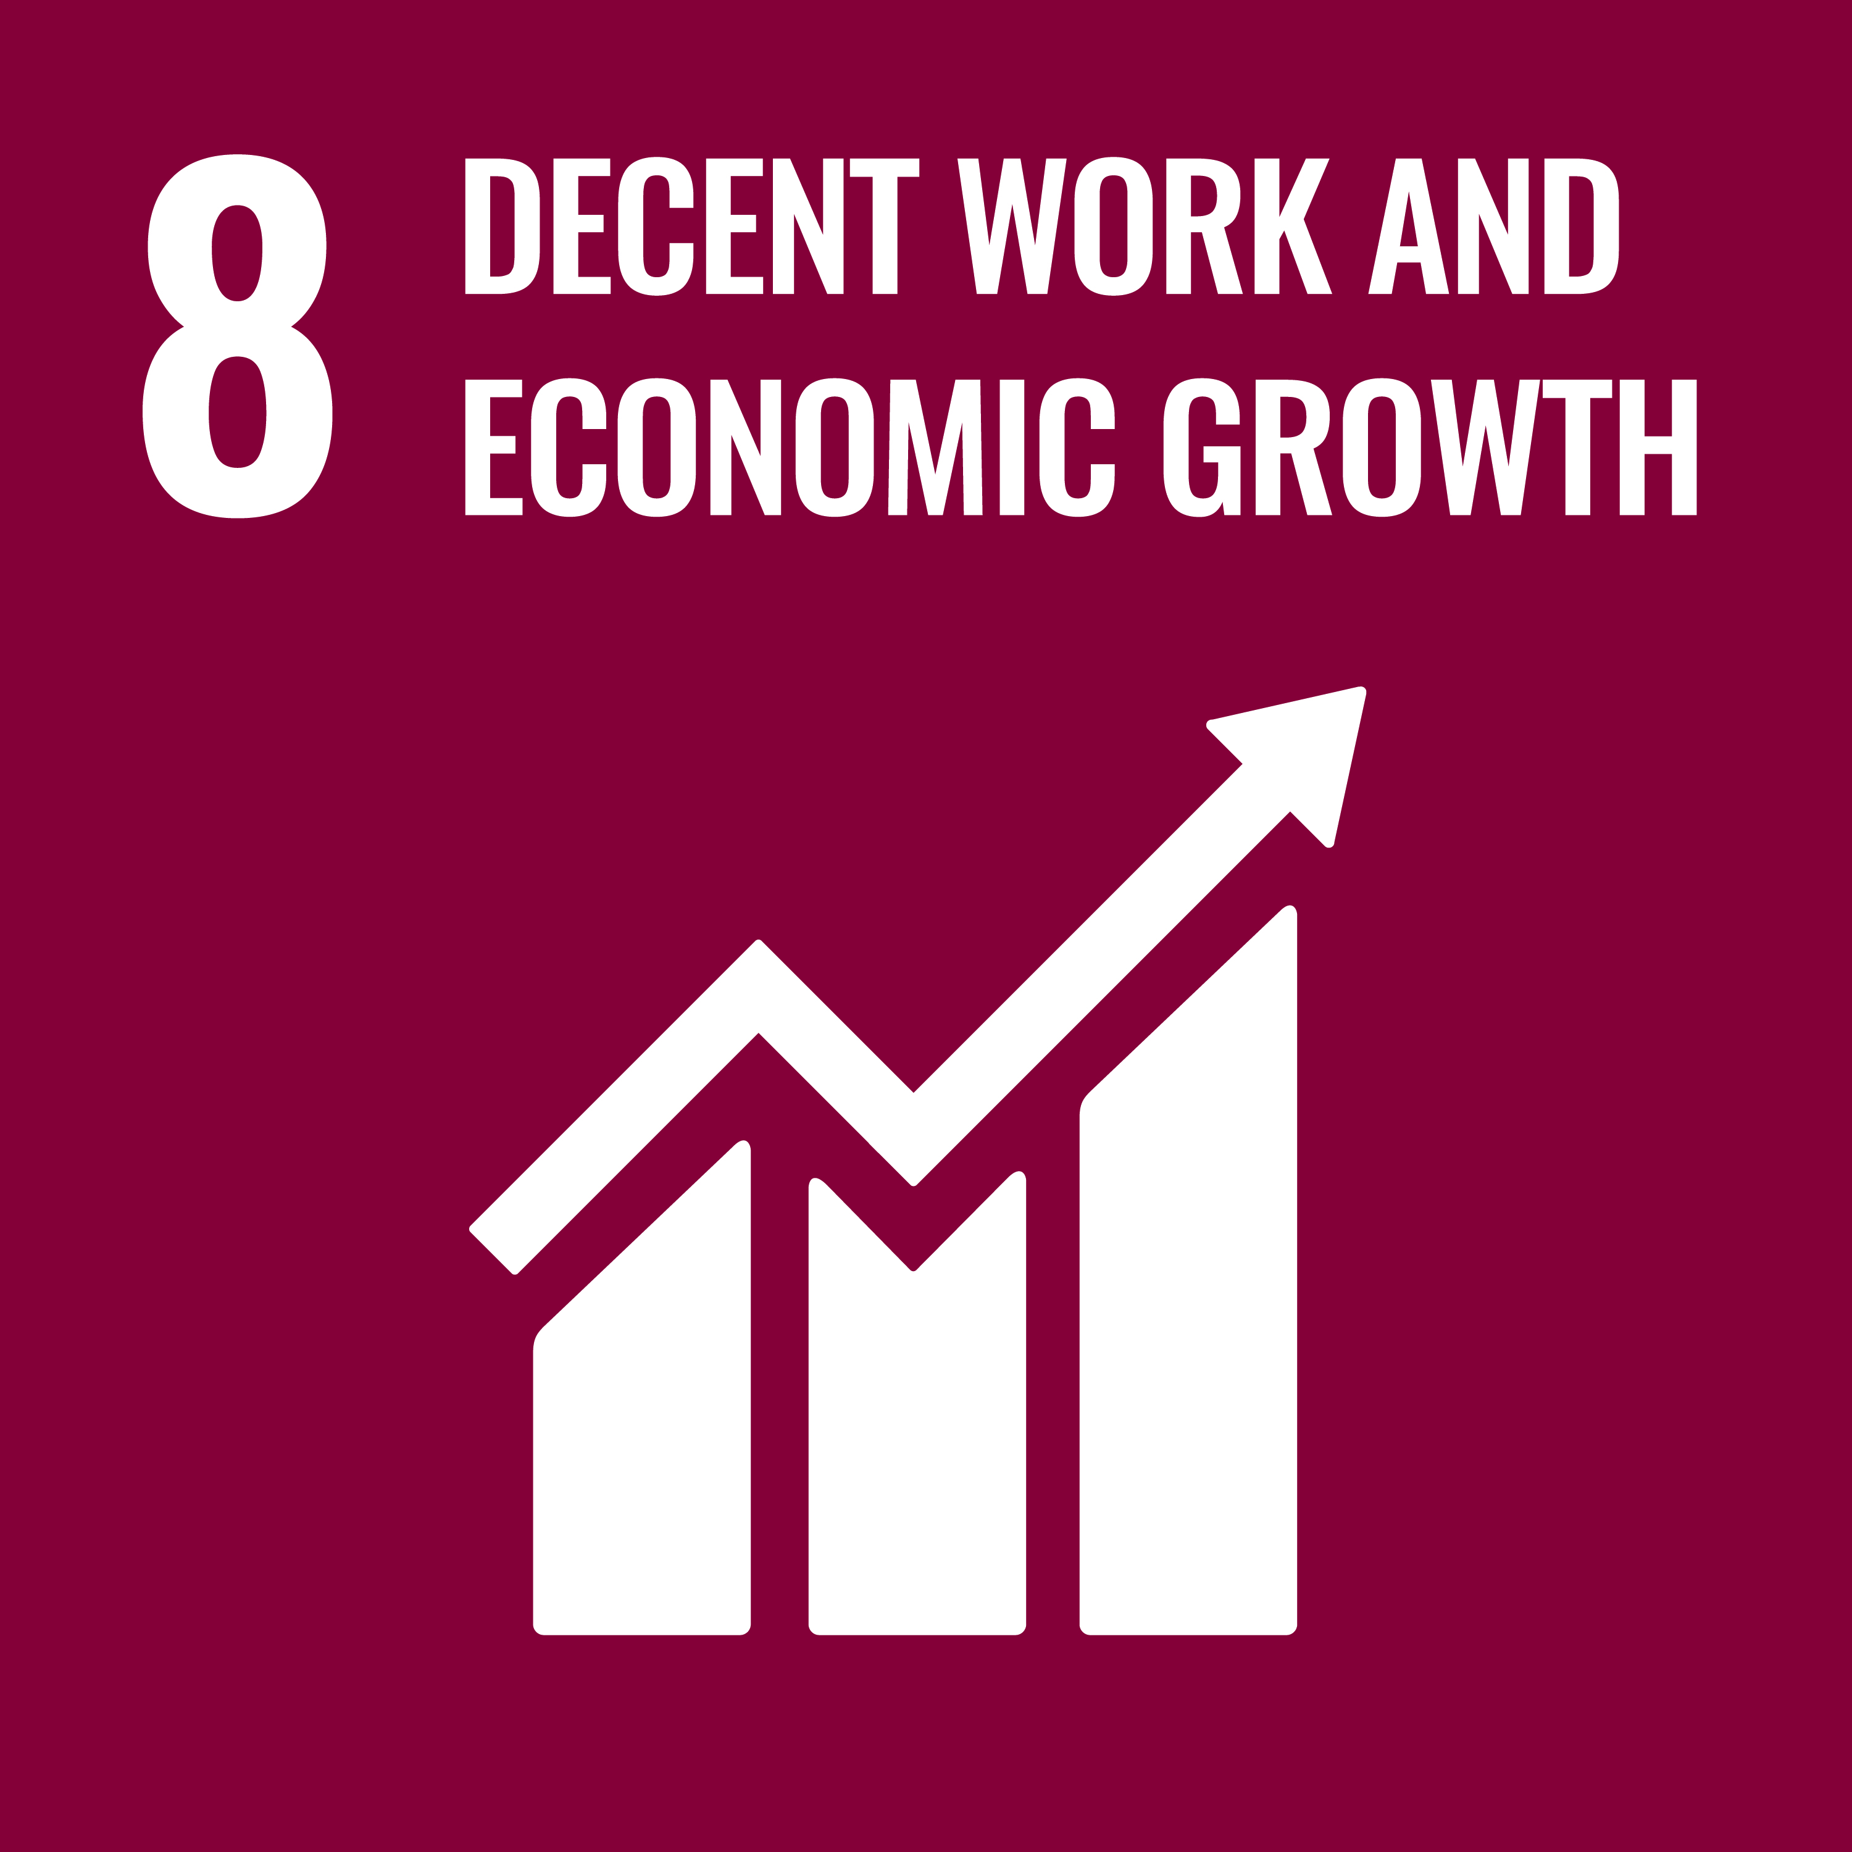
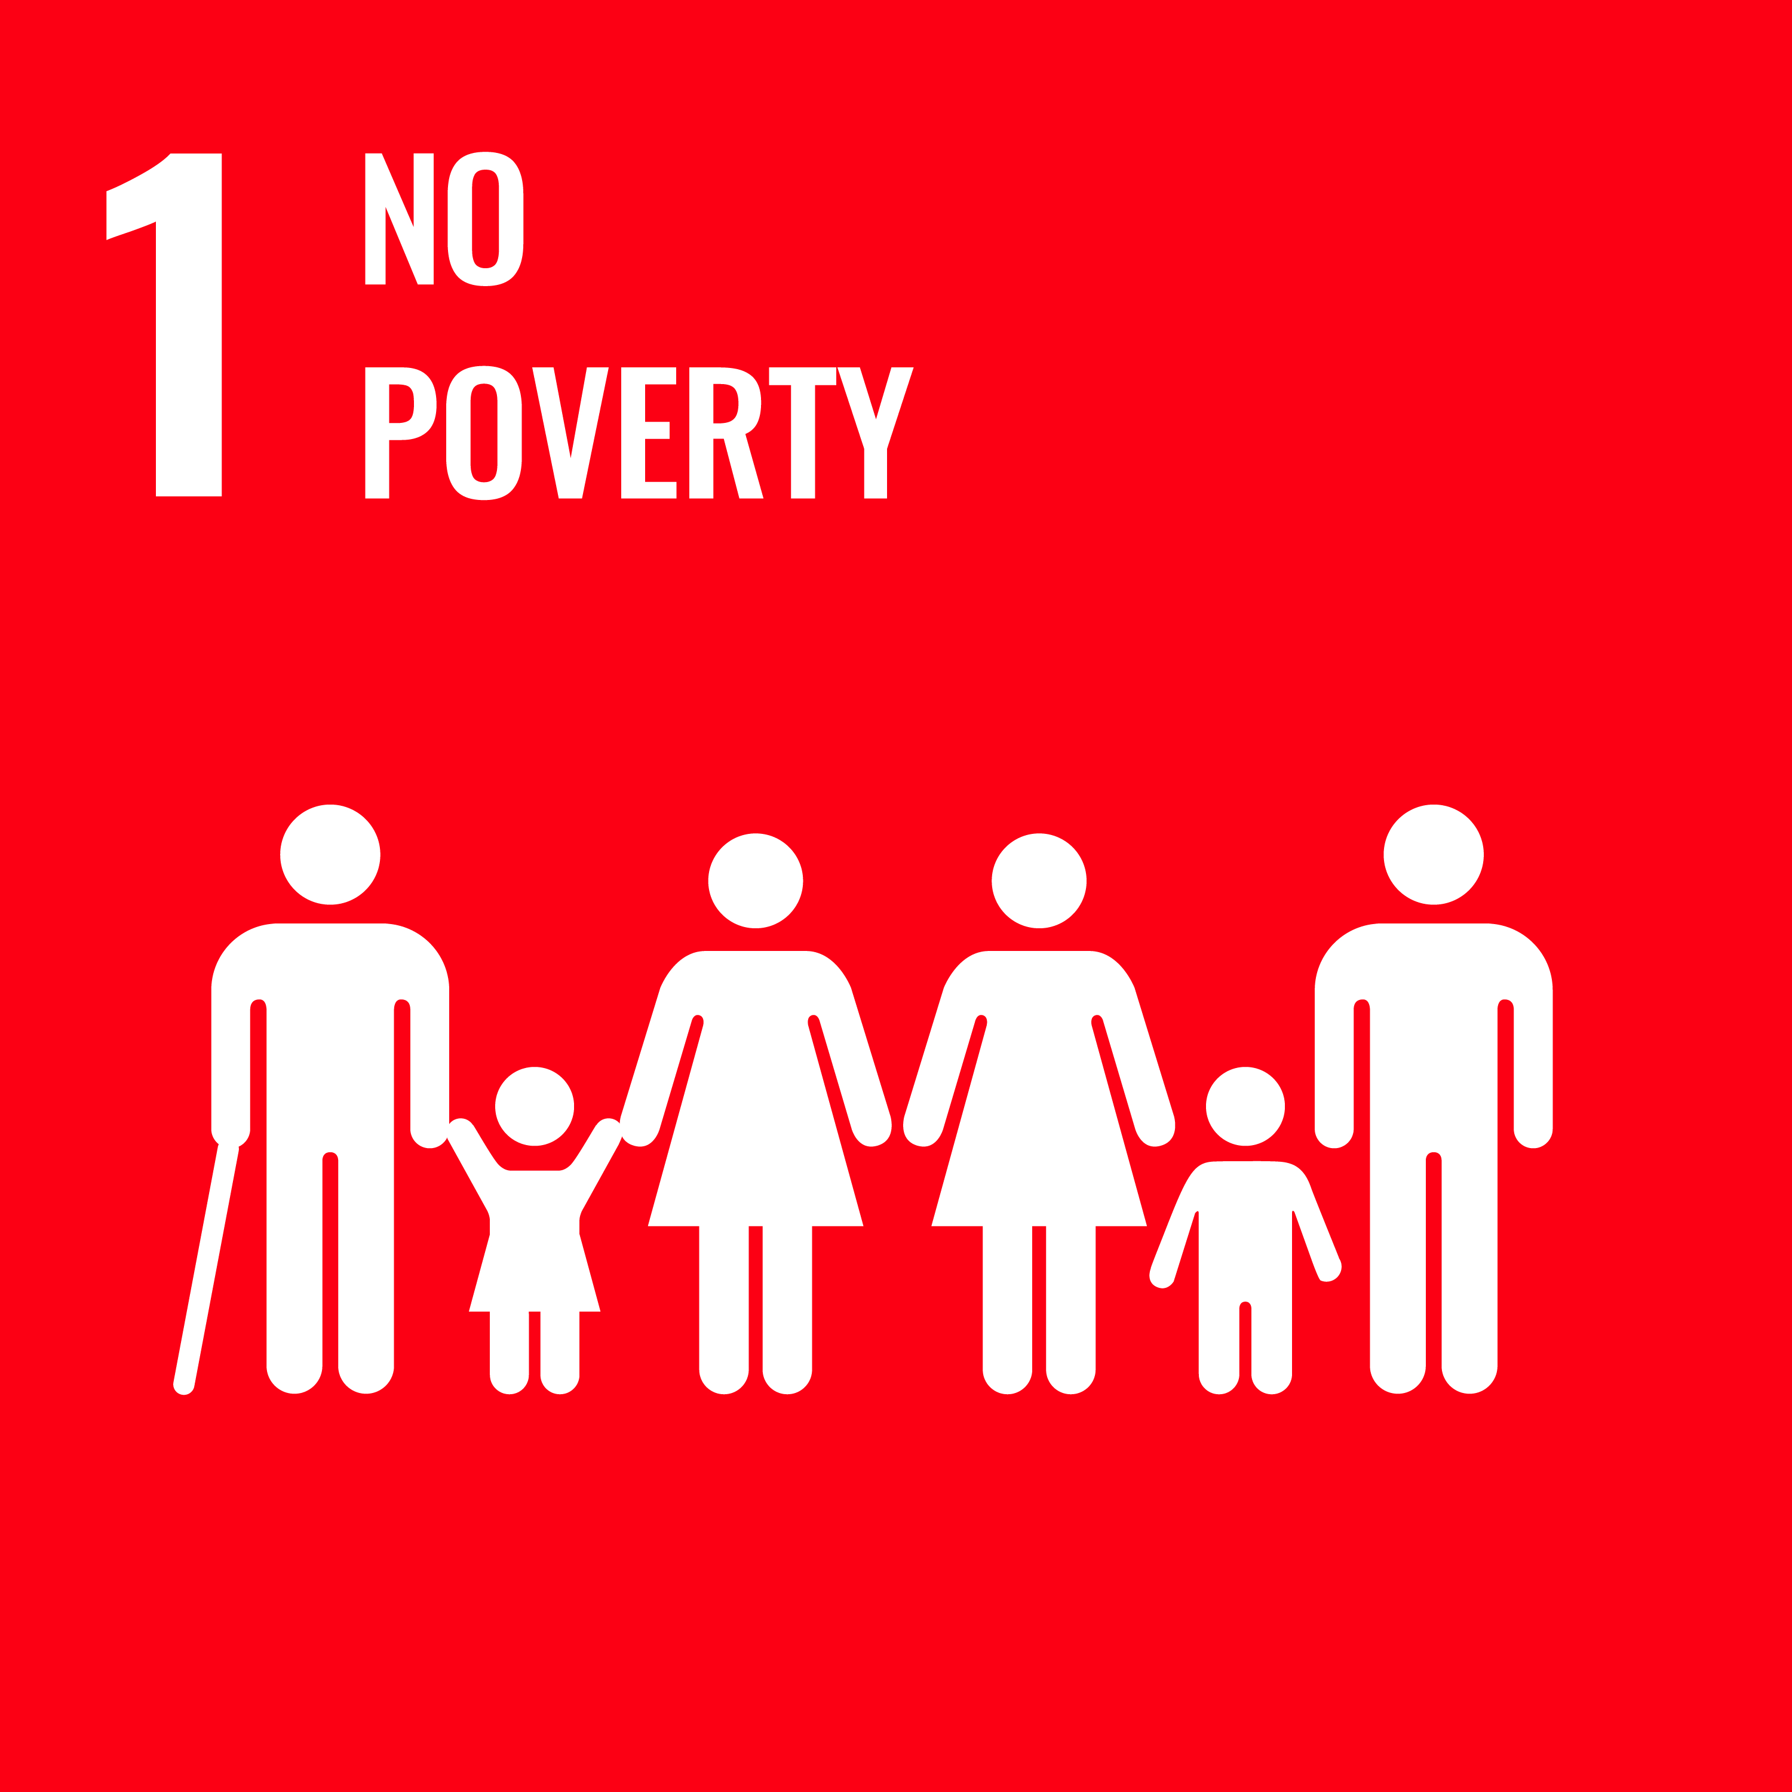

We have identified relevant business disclosures to assess the copper mining industry’s impacts in terms of elevating livelihoods
Copper Social Sustainability Potential
The UN SDG provides a consistent framework for mapping and tracking the impacts
Impacts | SDGs | Description of the targets | Relevant business disclosures
Employment Quality Provide equal & safe employment |  | Target 8.5 - By 2030, achieve full and productive employment and decent work for all women and men, including for young people and persons with disabilities, and equal pay for work of equal value. | Absolute metrics Total employment (#) Recordable injury frequency rate (#) Relative metrics Proportion of female / indigenous employment (%)
Household Income Increase household income & benefits |  | Target 1.2 - By 2030, reduce at least by half the proportion of men, women and children of all ages living in poverty in all its dimensions according to national definitions | Absolute metrics Payments to employees ($) Relative metrics Average employee wage & benefits ($)
Capacity Building Advance workforce’ skillset & careers |  | Target 4.4 – By 2030, substantially increase the number of youth and adults who have relevant skills, including technical and vocational skills, for employment, decent jobs and entrepreneurship. | Absolute metrics Allocated training budget ($) Relative metrics Average training investment per employee ($) Average hours of trainings per employee (Hours)
1
2
3
Source: Wood Mackenzie analysis, UN, GRI

Slide 43
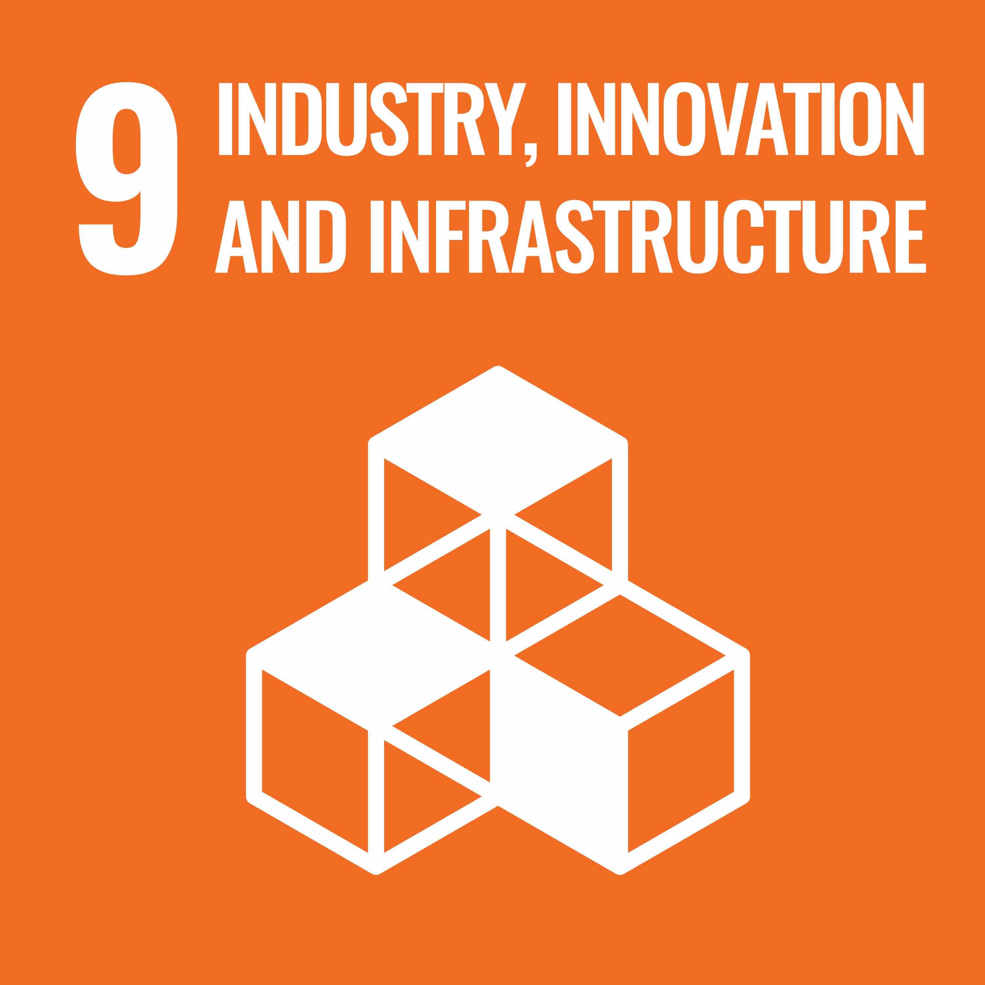
We have identified relevant business disclosures to assess the copper mining industry’s impacts in terms of distributing economic value
Copper Social Sustainability Potential
The UN SDG provides a consistent framework for mapping and tracking the impacts
Impacts | SDGs | Description of the targets | Relevant business disclosures
Institutional Reinforcement Contribute to government revenues |  | Target 8.1 – Sustain per capita economic growth in accordance with national circumstances and, in particular, at least 7 per cent GDP growth per annum in the least developed countries | Absolute metrics Payments to government ($) Relative metrics Split of government payments (%)
Industrial Diversification Support the local industrial ecosystem |  | Target 8.3 – Promote development-oriented policies that support productive activities, decent job creation, entrepreneurship, creativity and innovation, and encourage the formalization and growth of SMEs. | Absolute metrics Payments to suppliers ($) Relative metrics Proportion of in-country procurement (%) Proportion of local (regional) procurement (%)
Community Development Sustain the community development |  | Target 9.1 – Develop quality, reliable, sustainable and resilient infrastructure to support economic development and human well-being, with a focus on affordable and equitable access for all | Absolute metrics Community investments ($) Executed disbursements ($) Relative metrics Split of community investments (%)
4
5
6
Source: Wood Mackenzie analysis, UN, GRI

Slide 44
For each of the socio-economic impacts which were defined previously, we have identified relevant RMI policy & practice enablers
Copper Social Sustainability Potential
Those enablers are put in place at the corporate level (global and/or local)
Socio-economic Impacts | Description of relevant policy & practice enablers
Employment Quality Provide equal & safe employment | Working conditions: The company has systems in place to ensure its operations base their recruitment practices on the principle of equal opportunity, to prevent all forms of discrimination in the workplace & promote workforce diversity Working conditions: The company has systems in place to ensure its operations engage with worker representatives to collaboratively identify, assess, avoid, and mitigate health and safety risks to its workforce
Household Income Increase household income & benefits | Working conditions: The company tracks, reviews and acts to improve its performance on ensuring that its workers’ wages meet or exceed verified living wage standards, or legal minimum wage, whichever is the highest Community wellbeing: The company tracks, reviews and acts to improve its performance on respecting the rights and aspirations of Indigenous Peoples and avoiding adverse impacts on their livelihoods and heritage
Capacity Building Advance workforce’ skillset & careers | Economic development: The company has systems in place to ensure its operations support STEM education and technical / vocational skills development among the wider population Economic development: The company has systems in place to ensure its operations support technical and managerial skills development of its local workforces
Institutional Reinforcement Contribute to government revenues | Business conduct: The company publicly discloses all payments it makes to sub-national and national governments, providing disaggregated data on a project-level basis Business conduct: The company tracks, reviews and acts to improve the effectiveness of its whistleblowing mechanisms for reporting concerns about unethical behaviour (e.g. anti-bribery and corruption)
Industrial Diversification Support the local industrial ecosystem | Economic development: The company has systems in place to ensure its operations develop procurement opportunities for suppliers at national and supranational levels Economic development: The company has systems in place to ensure its operations encourage local entrepreneurship and support local business development, including for women
Community Development Sustain the community’s development | Economic development: The company has systems in place to ensure its operations work collaboratively with sub-national producing country governments on socio-economic development planning Lifecycle management: The company has systems in place to ensure its operations plan and manage post-closure transition in collaboration with affected communities, to seek to ensure continued viability of their livelihoods
1
2
3
4
5
6
Source: Wood Mackenzie analysis, RMI

Slide 45
For each of the socio-economic RGI which were defined previously, we have identified relevant RGI policy & practice enablers
Copper Social Sustainability Potential
Those enablers are put in place at the governmental level (national and/or local)
Socio-economic Impacts | Description of relevant policy & practice enablers
Employment Quality Provide equal & safe employment | Revenue management: Local content practice; is local content promoted? Are there rules in law / public policy which require public reporting of local employment statistics? Has the government published local employment statistics? Revenue management: Extractive revenues; does the government publicly disclose projections of extractive resource revenues? For the most recent year, did the government publicly disclose the total resource revenue received?
Household Income Increase household income & benefits | Value realization: Landowners compensation requirement; are there rules governing expropriation, compensation and resettlement to landowners or users of land when project development interferes with the land they own or use? Value realization: Sovereign wealth fund; does the country have a natural resource fund which is funded by extractive resource revenues? If so; is the sovereign wealth fund required to produce & disclose annual financial reports?
Capacity Building Advance workforce’ skillset & careers | Revenue management: Local content practice; is local content promoted? Are there rules in law / public policy which require public reporting of local employment statistics? Has the government published local employment statistics? Value realization: Economic linkages; is the development of forward linkages promoted in laws, policies or by state equity? has the government published a baseline assessment informing the forward linkages policy?
Institutional Reinforcement Contribute to government revenues | Value realization: Public officials asset disclosure requirement; are senior public officials required to publicly disclose their financial holdings in extractive companies? Value realization: Payment disclosure requirement; is the government required to publicly disclose data on payments from extractive companies to the government?
Industrial Diversification Support the local industrial ecosystem | Revenue management: Subnational resource revenue transfer; does the central government transfer extractive resource revenues to subnational governments? Are these rules specific (distinct) for the extractive resource industry? Revenue management: Subnational resource revenue sharing; does the resource revenues sharing formula (if it exists) specify the amount of revenue received by each subnational government, either by amount, indicator or share of resource revenues?
Community Development Sustain the community’s development | Value realization: Social impact assessment requirement; are extractive companies required to prepare an SIA prior to development? Is there a requirement for the SIA to be publicly disclosed? Value realization: Environmental impact assessment requirement; are extractive companies required to prepare an EIA prior to development? Is there a requirement for the EIA to be publicly disclosed?
1
2
3
4
5
6
Source: Wood Mackenzie analysis, RGI

Slide 46
Comparing Chile and the DRC’s RGI scores, respectively the highest and lowest ranked, provides a perspective on best practices
Copper Social Sustainability Potential
The Enabling Environment is critical to realizing the full value out of extracted resources
30%
33%
37%
Value Realization
Enabling Environment
Revenue Management
60%
24%
16%
Value Realization
17%
23%
29%
31%
Licensing
Local Impact
Taxation
State Owned Enterprises
26%
27%
26%
21%
Revenue Management
National Budgeting
43%
57%
Sovereign Wealth Funds
67%
33%
Enabling Environment
Voice & Accountability
Control of Corruption
15%
14%
15%
15%
15%
13%
13%
Government Effectiveness
Political Stability
Regulatory Quality
Open Data
Rule of Law
Source: Wood Mackenzie analysis, 2021 RGI data. Note: Where 2021 data is unavailable for selected countries, 2017 data has been used in place

