Slide 1
Panel Discussion—Copper and a Sustainable Society

Slide 2
Antitrust Guidelines for Copper Industry Trade Association Meetings
The following guidelines with respect to compliance with antitrust laws of the United States, Japan and European Community¹ are intended to govern the conduct of participants in copper industry trade association meetings, both at the meeting itself and in informal discussions before or after the formal meeting.
Price: Competitors should not discuss future prices (including terms of sale) of their products. There is no blanket prohibition against the mention of or reference to current or past prices but limits must be observed. Such references or mentions should occur only when necessary in connection with the development of association programs. For example, reference to a particular price level in comparing the cost of a copper product to a competing product is permitted. Whenever possible, such references should be discussed in advance with legal counsel.
Competitive Information: Competitors should not discuss the market share of a particular copper producer or copper fabricator’s products. Furthermore, nothing should be said at a meeting which could be interpreted as suggesting prearranged market shares for such products or producer production levels. The overall market share of copper products may be discussed with regard to competition with non-copper products and general market acceptance.
New Products: Competitors should not encourage or discourage the introduction of a new product by another competitor or reveal a particular copper company’s plans to change the production rate of an existing product or to introduce a new product. No company should disclose to another company whether it is in a position to make or market a new product. New products may be discussed in a technical manner or from the standpoints of competition with non-copper products and general market acceptance. In addition, proposed methods for and results of field and laboratory testing can be considered.
The Role of Legal Counsel: Legal counsel attends association meetings to advise association staff and other meeting attendees regarding the antitrust laws and to see that none of the matters discussed or materials distributed raise even the appearance of antitrust improprieties. During the course of a meeting, if counsel believes that the discussion is turning to a sensitive or inappropriate subject, counsel will express that belief and request that the attendees return the discussion to a less sensitive area.
A paper entitled ‘Copper Industry Trade Associations and Antitrust Laws’ is available upon request.
10/92, 5/93, 10/10
1. Other foreign competition laws apply to International Copper Association, Ltd. ICA’s activities worldwide.
Notes:
TO CHANGE

Slide 3
The Social and Economic Impacts of Copper Production
Panel 1

Slide 4
Wood Mackenzie analysis has identified key thought-leading facts about the socio-economic value contribution of the copper mining sector
The copper mining sector distributes an average of ~$73B per year in socio-economic value globally, where Latin America contributes over 50 percent of that value
There is ~2Bt of identified copper resources remaining in the ground globally, which at the current production rate, is sufficient to address our needs for over 100 years
That resource, yet to be mined, is worth ~$4T in potential socio-economic value to be realized, with ~55 percent of it located in the Americas (notably Chile, Peru, USA, Mexico, Canada), of which ~30 percent sits in Chile only
The copper mining sector can contribute as much as ~9.5 Percent of a country’s GDP, sometimes more than Agriculture, especially in regions where mining is a pillar of the economy
There is additional ~$20B worth of socio-economic value which gets extracted on a yearly basis as a result of copper mining, but is not distributed due to poor governance practices in selected jurisdictions
Source: Wood Mackenzie
Panel Discussion – Copper and a Sustainable Society
9-Oct-23
4

Slide 5
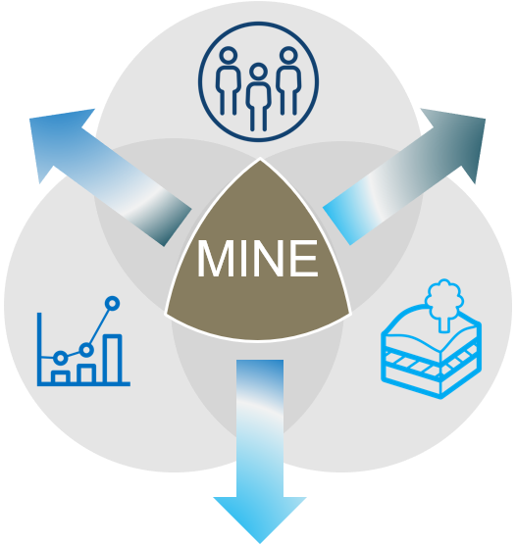
Copper mining adds social and economic value to communities
Socially Equitable
Elevate livelihoods through enabling quality employment
The public REGULATOR influences socio-economic returns and socio-political stability
SOCIETY influences the protection of indigenous communities and the environmental ecosystem
Economically Beneficial
Distribute financial value fairly across stakeholders
Environmentally Sustainable
Make the best use of our collective natural capital
Source: Wood Mackenzie
The mine OPERATOR influences financial sustainability while fulfilling the supply of strategic minerals
Panel Discussion – Copper and a Sustainable Society

Slide 6
Enabling Policies and Regulations for Copper Production
PANEL 2

Slide 7
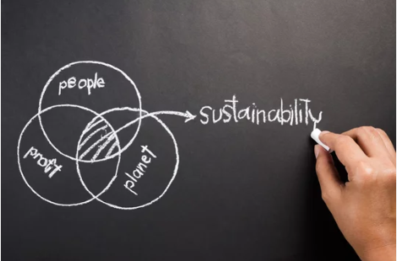
National Government
Local Government
Industry Best Practice

