Slide 1
Power Cable in New and Emerging Markets

Slide 2
POWER CABLE – MARKET & REGULATORY ENVIRONMENT
In 2021, US rejoined Paris Agreement with target to reach net zero emissions by 2050. US has set goal to reach 100% carbon pollution-free electricity by 2035
Increasing distributed energy resources (DERs) are putting pressure on ageing T&D network to integrate new technologies
Advanced economies have completed several rounds of investments in grid-modernization technologies
Renewable Energy Directive establishes rules for EU to achieve 32% renewables target by 2030
European automotive industry is making rapid transition to EV market
This, in turn, will translate into high demand for fast charge technology cables from end users
Germany’s new Renewable Energy Act 2021 (EEG 2021), passed in 2020, set a carbon neutrality target for 2050 and a 100 GW solar capacity target for 2030
In 2020, Ten Year Network Development Plan 2020 (TYNDP) aims to lay 46,000 km for both refurbishment and new lines across Europe by 2030 to meet growing consumer demand
China released an industrial development plan for new energy vehicles for 2021–2035; it has proposed a target of 20% for new energy vehicles in the market by 2025
California passed an executive order committing to 100% zero-emission passenger cars and light-duty trucks in new vehicle sales by 2035
Under World Green Building Council’s net zero carbon buildings commitment (six sub-national states, 27 cities, and 79 businesses have committed to net zero buildings by 2050

Slide 3
POWER CABLE STATUS
Power cables are available in various load-carrying capacities and materials, and with varying voltage ranges; these can be installed either underground or overhead
Power cables are divided into three cable types; they include high-, medium- and low-voltage cables
Mainly used for transmission and distribution of electrical energy in power utilities, and for other applications
In 2021, overall global power cable market was 8.7 million mt in volume terms
Copper constitutes 54% of overall demand followed by aluminum with 46%
Key factors driving growth
Increase in demand for electricity coupled with increased population and urbanization
Commitment from key countries towards implementing Paris agreement
Rising trend of renewable energy generation around the globe
Rise in switch from overhead lines to underground lines
Replacement of older grid infrastructure
Encouraging policies and initiatives of various governments and incentives

Slide 4
REGIONAL VIEW
In 2021, China was the leading consumer of copper in power cables
ROW leads in aluminum use followed by Europe, with ~62% and ~18% respectively
Copper power cable market, by Region (kmt)
Aluminum power cable market, by Region (kmt)
4,700

Slide 5
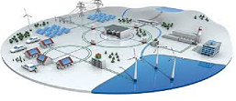
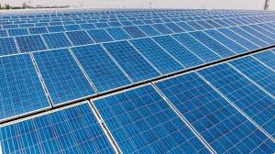
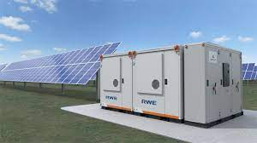
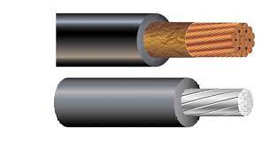
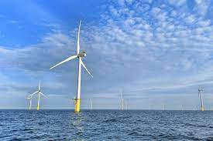
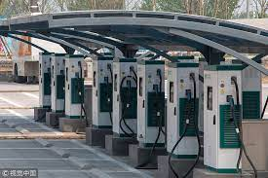
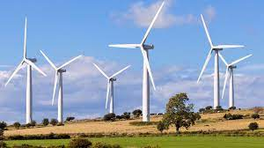
MARKET DEVELOPMENT
According to the Paris Agreement, reducing energy-related CO₂ emissions in every region across the globe is necessary to shift from consumption of fossil fuels that cause climate change to cleaner, renewable forms of energy
Solar, along with wind energy and EV infrastructure, will play a critical role
Solar Power
In Solar PV cables is used for transmitting electrical power
Cable is used to conduct electricity
Heat exchangers are used to transfer solar energy
Other emerging technologies
01
Smart city - transport mobility, energy, infrastructure, and smart buildings, data Centre
Offshore wind power
05
02
Cable within Tower
Inter-connecting Towers (& to Farm step-up)
Ground W&C Usage
Cable from Tower to Pad
Electronic and data transmission cable
EV Charging station
Charging pad
Vehicle charging points
Cable Assembly
Cord extension set
04
03
Onshore wind power
Cable within Tower
Inter-connecting Towers (& to Farm step-up)
Ground W&C Usage
Cable from Tower to Pad
Electronic and data transmission cable

Slide 6
COPPER POWER CABLE DEMAND – WIND
Global wind electricity systems installation is expected to reach ~2917 GW through 2040
China is expected to be the world leader in wind installation, reaching 1367 GW; followed by Europe ~590 GW
Copper consumption is expected to reach 6.44 million mt through 2040
Wind installed capacity
Copper consumption
a-includes South America, Middle East, Asia Pacific excluding China, Africa, etc.

Slide 7
COPPER POWER CABLE DEMAND – SOLAR
Global solar electricity systems installation is expected to reach ~5,700 GW through 2040
China is expected to be the world leader with ~2,230 GW followed by North America ~1,250 GW
Copper demand is expected to reach ~6.41million mt through 2040
Solar installed capacity GW
Copper consumption
a-includes South America, Middle East, Asia Pacific excluding China, Africa, etc.

Slide 8
COPPER POWER CABLE DEMAND – EV CHARGING
EV charging ports are expected to rise exponentially from 3.2 million in 2021 through 152 million through 2040
China is expected to be global leader in EV charging port infrastructure development; likely to reach 145 million ports
Copper demand is expected to reach ~978 kit through 2040 from current use of 43 kmt in 2021
EV Charging Ports
Copper consumption
a-includes South America, Middle East, Asia Pacific excluding China, Africa, etc.

Slide 9
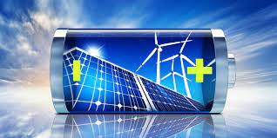
EMERGING COPPER POWER CABLE MARKET
SMART GRID: “Smart grid” generally refers to a class of technology used to bring utility electricity delivery systems using computer-based remote control and automation
USA has allocated US$4.5 billion for grid modernization under the American Recovery Reinvestment Act of 2009
China’s State Grid Corporation has outlined plans in 2010 for a pilot smart grid program; it maps out deployment through2030
Significant economies of scale in power grid construction and development have brought huge market demand and innovation to cable industry
European countries like Italy, Spain, UK and France are upgrading meters and investing in smart grids features and modernizing networks
Modernization with automation of grids is expected to drive copper consumption
ENERGY STORAGE: The largest markets are USA, Western Europe and China. Market drivers are energy independence and security; smart grid investments; time of use/peak demand rates; growth in renewable and distributed generation; and government policies, incentives and regulations
Due to copper’s key core competitive advantages--reliability, efficiency, durability and safety, the metal is critical to the fundamental design of battery cells
Copper is also important in the manufacture of Li-ion batteries
At the cell level, copper is used in anode current collectors; at the pack level, it is used in electrical interconnects, for example – bus bars, cables and wiring
DATA CENTERS: Data centers are driven by growing demand for edge computing; this is a distributed computing framework that brings enterprise applications closer to data sources such as Internet of Things devices or local edge servers
Large data centers and hyperscale data centers are the future for data storage in response to rising edge computing, smart cities, and increased use of smart phones and digitization
Size of China’s data center market in 2019 was US$ 13.01 billion; it is expected to reach US$ 36.18 billion in 2025 exhibiting a CAGR of 19.2% from 2020 to 2025
Increased demand for data centers will lead to infrastructure network expansion, which in turn, will drive copper consumption

Slide 10
B&C AND SMART CITY MARKET TRENDS
B&C: Building and construction is expected to grow at 9-10% CAGR. Smart building adaptations will lead to increased copper consumption
Green regulations in building standards like ASHRAE (USA), Eurocodes (EU), and voluntary certification such as LEED (US Green Building Council), Green Star (Australia), CASBEE (Germany), BREEAM (UK BRE) are likely to become increasingly strict, and also enforced
Global demand for copper in climate-related commercial retrofitting market is likely to grow rapidly in response to growing adoption of green energy technologies and co-generation, HVAC efficiency, lighting efficiency, building envelopes, free cooling etc.
Smart Cities: A smart city is an urban area that utilizes IoT sensors, actuators, and different types of electronic Internet of Things technology to connect components across the city. It impacts every layer of a city, from underneath the streets, to the air that citizens are breathing. Data from all segments is collected and analyzed, and then insights and patterns are detected to better manage assets, resources and services efficiently
Asia and Europe currently lead the world in copper demand for use in smart cities, at 40% and 35% respectively
North America has a market share of 20%
By 2030, North America will have the highest growth and will be at par with Asia and Europe
In China, smart cables are an indispensable in smart cities
With the help of smart cities, a comprehensive intelligent management platform, the intelligent application of smart cables is likely to expand further with growing expansion and reliance of 5G networks on cables
Arrival of 5G networks has increased reliance on some key components significantly, especially connectors and cables used in wireless and wired infrastructure
Key sectors, including transport mobility, energy, infrastructure, and smart buildings, all use copper. As the adoption of new copper-based technologies increases, forecast shows copper demand in smart buildings will be a large growth area

Slide 11
EMERGING TECHNOLOGIES
Emerging technologies i.e. building & construction, RE, data centers, and EV are expected to drive overall copper demand through 2035
Building & construction and RE segments are expected to drive maximum growth among all emerging technologies
Copper Demand – Emerging Technology (kmt)
1,130
5,760
8,600
8,267
e-estimated

Slide 12
POWER CABLE FORECAST
Copper demand from power cables expected to reach 8.7 million at 4.5% CAGR through 2035
Aluminum, an alternative energy conductor, is expected to experience a slower growth, at 3.9% CAGR through 2035
Copper Demand – Emerging Technology (kmt)
8,700
10,370
13,035
15,625
e-estimated

