Slide 1
Iron Silicate: A Versatile and Sustainable Substitute for Natural Minerals
Opportunities for Industrial Symbiosis in the Copper Industry.
21 October 2021

Slide 2
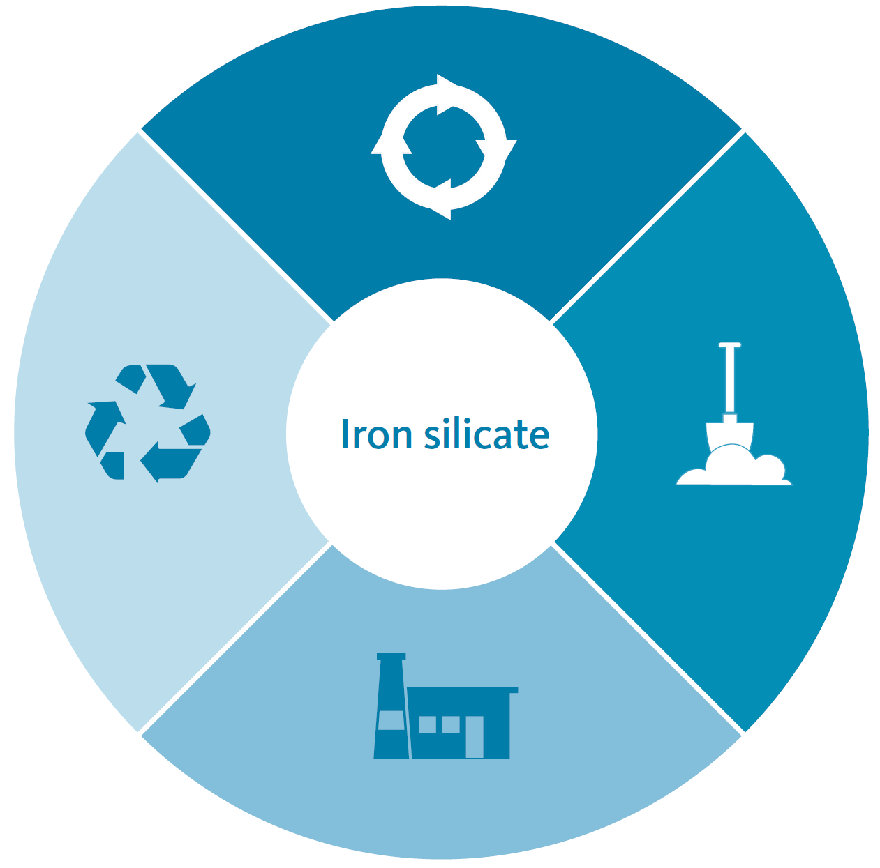
Iron silicate: Engineered mineral with considerable potential in circular economy and climate protection
Closing the loop
Using this valuable manufactured mineral actively contributes to the circular economy and increases resource efficiency.
Waste prevention
Iron silicate is an integral part of copper production; not using it would turn a sustainable product into waste for landfill.
Saving natural resources
Using iron silicate helps
to conserve scarce natural minerals such as gravel, sand, and mineral flour.
Industrial symbiosis
Using manufactured minerals in the construction sector facilitates industrial symbiosis towards greater circularity and climate neutrality.

Slide 3
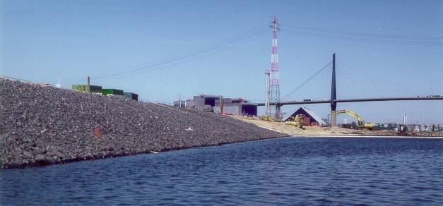
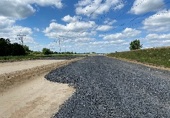
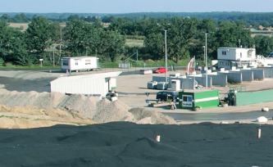
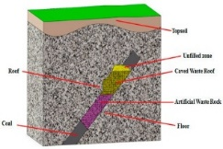
What is iron silicate used for?
Hydraulic Engineering
Amourstone for coastal and embankment protection or scour protection
Concrete
Iron Silicates can be used as a filler or aggregate in the concrete mixture
Road Construction
Aggregates are used to create the base layer below closed top layers
Landfill construction
Material is used for different applications in the construction of landfilling body
Abrasives
After drying and screening material is used for corrosion protection as blasting grit
Soil stabilization
Material is used for stabilization construction, e.g. Ski- & Alpincenter Bottrop
Clinker & Cement
Iron Silicates can be used as iron corrector or for higher value scm´s in the process
And many more…
Emerging markets
Ceramics, Dry mixtures, Asphalts, Coal flotation

Slide 4
Policy recommendations
Construction Products regulation
Encouraging the use of engineered minerals in construction
Introduce minimum recycled content quota
Mandatory preference to secondary mineral aggregates
Favour products with low overall environmental footprint
Promote recycling management tools
Ensure product status
Construction product standards
Securing that construction product standards do not hamper uptake of alternative materials
Stimulate update of existing standards to include engineered minerals
Develop new standards based on performance requirements
Industrial symbiosis
Promote Industrial Symbiosis
Stimulate sector integration and a market for engineered minerals
Reward synergies in the transition towards a climate neutral an more circular economy
Notes:
(avoid prescriptive product formulations)
1. Encourage the use of engineered minerals in construction, replacing natural mineral aggregates
Increased circularity becomes more important to reduce emissions, optimize use of raw materials and contribute to security of supply.
Policy measures shall promote the uptake of secondary mineral aggregates (such as engineered minerals) in construction by introducing
minimum recycled content quota for mineral aggregates or
obligation to give preference to secondary mineral aggregates
We further support giving preference to products with a low overall environmental footprint.
Why this proposal?
The Construction Products Regulation (CPR) is a central piece of the current policy framework for construction products in the EU. The CPR is being revised. A range of indicative options to revise the CPR has been detailed by the European Commission, including promoting a circularity and recycled content.
Today there are no incentives to use engineered minerals from other industry in the production of cement and concrete. Stones, limestone/other natural constituents of construction products are widely abundant and easily accessible to most cement plants and construction industry.
The recycled content approach is not appropriate for metals because there is high demand and uptake of secondary raw materials, and the availability of secondary raw materials is even lower than the demand. The focus for metals shall be on the recyclability at the end of life to Improve the collection and recycling efficiency.
In contrary, currently there is low demand and uptake of secondary mineral aggregates. The recycled content approach is needed to boost the market for secondary mineral aggregates.
The need for different approach to address recycling for different materials has been acknowledged in the Environmental footprint circular formula.
In terms of volume, construction and demolition waste represents the largest single group of all waste types in Europe. A substantial part of this waste is concrete. There are concerns about the end of life of concrete containing slags.
Encourage measures to promote recycling management through the use of tested, quality-controlled and available substitute building materials. Tools could facilitate the recycling of construction products at the end-of-life by providing information about the previous use of materials (e.g information in cadastral and notification requirements, product passports).
Construction product standards shall not block the uptake of alternative materials
Stimulate the update of existing standards to include engineered minerals.
Develop new standards based on performance requirements instead of prescriptive product formulations. This will open the possibility to various use of materials and allow easier acceptance of alternative and low carbon materials.
Why this proposal?
It is important to remove the current barriers in harmonised standards and facilitate the use of engineered minerals already produced by industry. For the use of minerals in the construction sector, specific technical requirements have to be fulfilled, and the material has to be included in harmonised standards.
The standards are developed by CEN outside of the legislation and the revision process is very slow. Also these norms correlate the list of “ingredients” with performance characteristics and binder behaviour. While this approach is meant to ensure the quality of the products, it leaves little space for uptake of low carbon alternatives and clinker substitution. It is a barrier for innovation.
The standardisation process shall be improved to ensure the timely adoption of product standards to allow low-carbon cement and concrete to be put on the market, and facilitate access to alternative raw materials such as iron silicate enabling lower carbon cements. In the future the Commission wants to be empowered to adopt Delegated or Implementing Acts containing, technical specifications, detailed product requirements.
Enhance green public procurement
Green public procurement shall create incentive for use of secondary aggregates /engineered minerals that substitute natural resources in construction
Support the move a mandatory green public procurement criteria and targets in legislation.
Tender specifications for public infrastructure works and buildings shall include indicators for a minimum share of secondary mineral aggregates and engineered minerals.
Integrate life cycle assessment in the public procurement criteria.
Why this proposal?
Green public procurement offer opportunity to incentivise the take up of secondary aggregates Currently there are voluntary Green Public Procurement (GPP) criteria in road construction
No binding targets are set.
The Circular Economy action plan provides for Mandatory Green Public Procurement (GPP) criteria and targets in sectoral legislation and phasing-in mandatory reporting on GPP by 2021.

