Slide 1
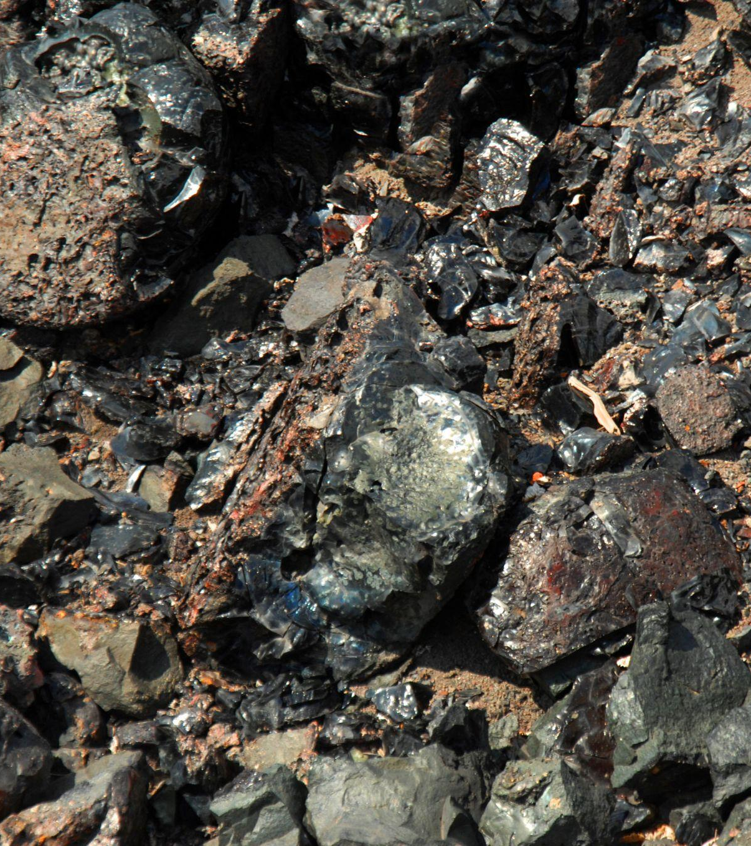
Using Waste and Byproducts as a Resource

Slide 2
Industrial symbiosis is the capture, recovery and reuse of previously discarded resources from one industrial operation by another, traditionally taking place between separate industries operating in close proximity.
Notes:
Extracting a specific byproduct with a quality meeting demand.
byproduct from Cu processing with a good-enough quality so to have a significant material flow.
Find a market for the byproduct.
A market (external and/or internal) was identified in the examples above, rendering the byproducts useful.
Make the industrial symbiosis exercise a business case (i.e., profitable).
The examples above managed to create a flow of materials between the Cu processor and the user of the byproduct, so to establish a permanent relationship
Implement industrial symbiosis practices with environmental, social, and economic benefits for the actors involved.
Environmental, social, and economic benefits have been achieved

Slide 3
Key success factors
Extract a specific byproduct with a desired quality
Make the industrial symbiosis exercise a business case (i.e., profitable).
Find a market for the byproduct.
Implement industrial symbiosis practices with environmental, social, and economic benefits for the actors involved.

Slide 4
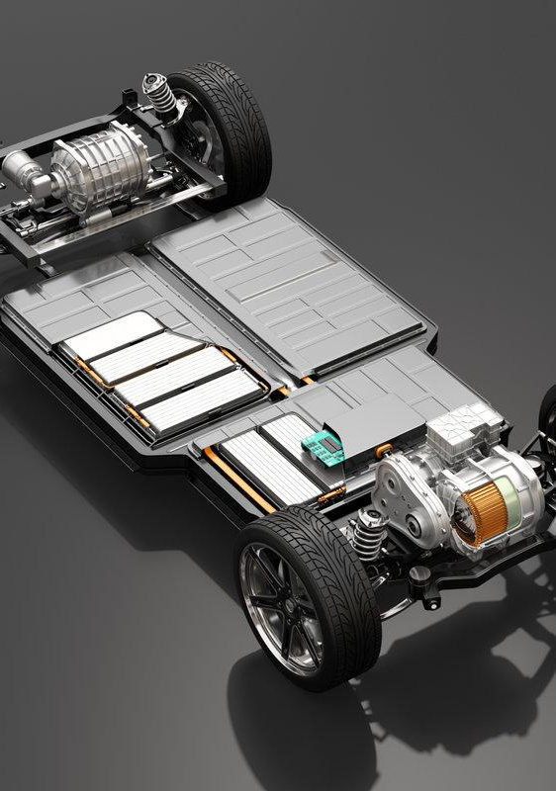
Drivers and enablers of industrial symbiosis
Diversity in industries
Geographic proximity of actors
Favourable legislation and policy
Need for reduction of raw materials and waste and their related costs
Economic/financial incentives
Availability of information to actors (on benefits, available resources in the area, etc.)
High cost of raw materials and waste treatment options
Sustainability-oriented mindset of actors involved

Slide 5
Conditions needed for industrial symbiosis
Specific legislation favouring industrial symbiosis practices, also economically
A matching system (a meeting place between producer of resources and potential users)
Scarcity (present or forecasted) and related price increase of some natural resources or metals
In certain cases, economic support could be considered (financial aid to promote shared resources over primary raw materials and energy)

Slide 6
Example: Specific EU legislation supporting industrial symbiosis
Waste Framework Directive (WFD) – Directive 2008/98/EC
Defines the concept of waste, but most importantly, defines when waste ceases to be waste and when a material flow is a byproduct and not a waste
Circular Economy Action Plan (CEAP)
The CEAP puts stress on circularity (circular material use), which improves the use of byproducts and EoL products, thus boosting industrial symbiosis

Slide 7
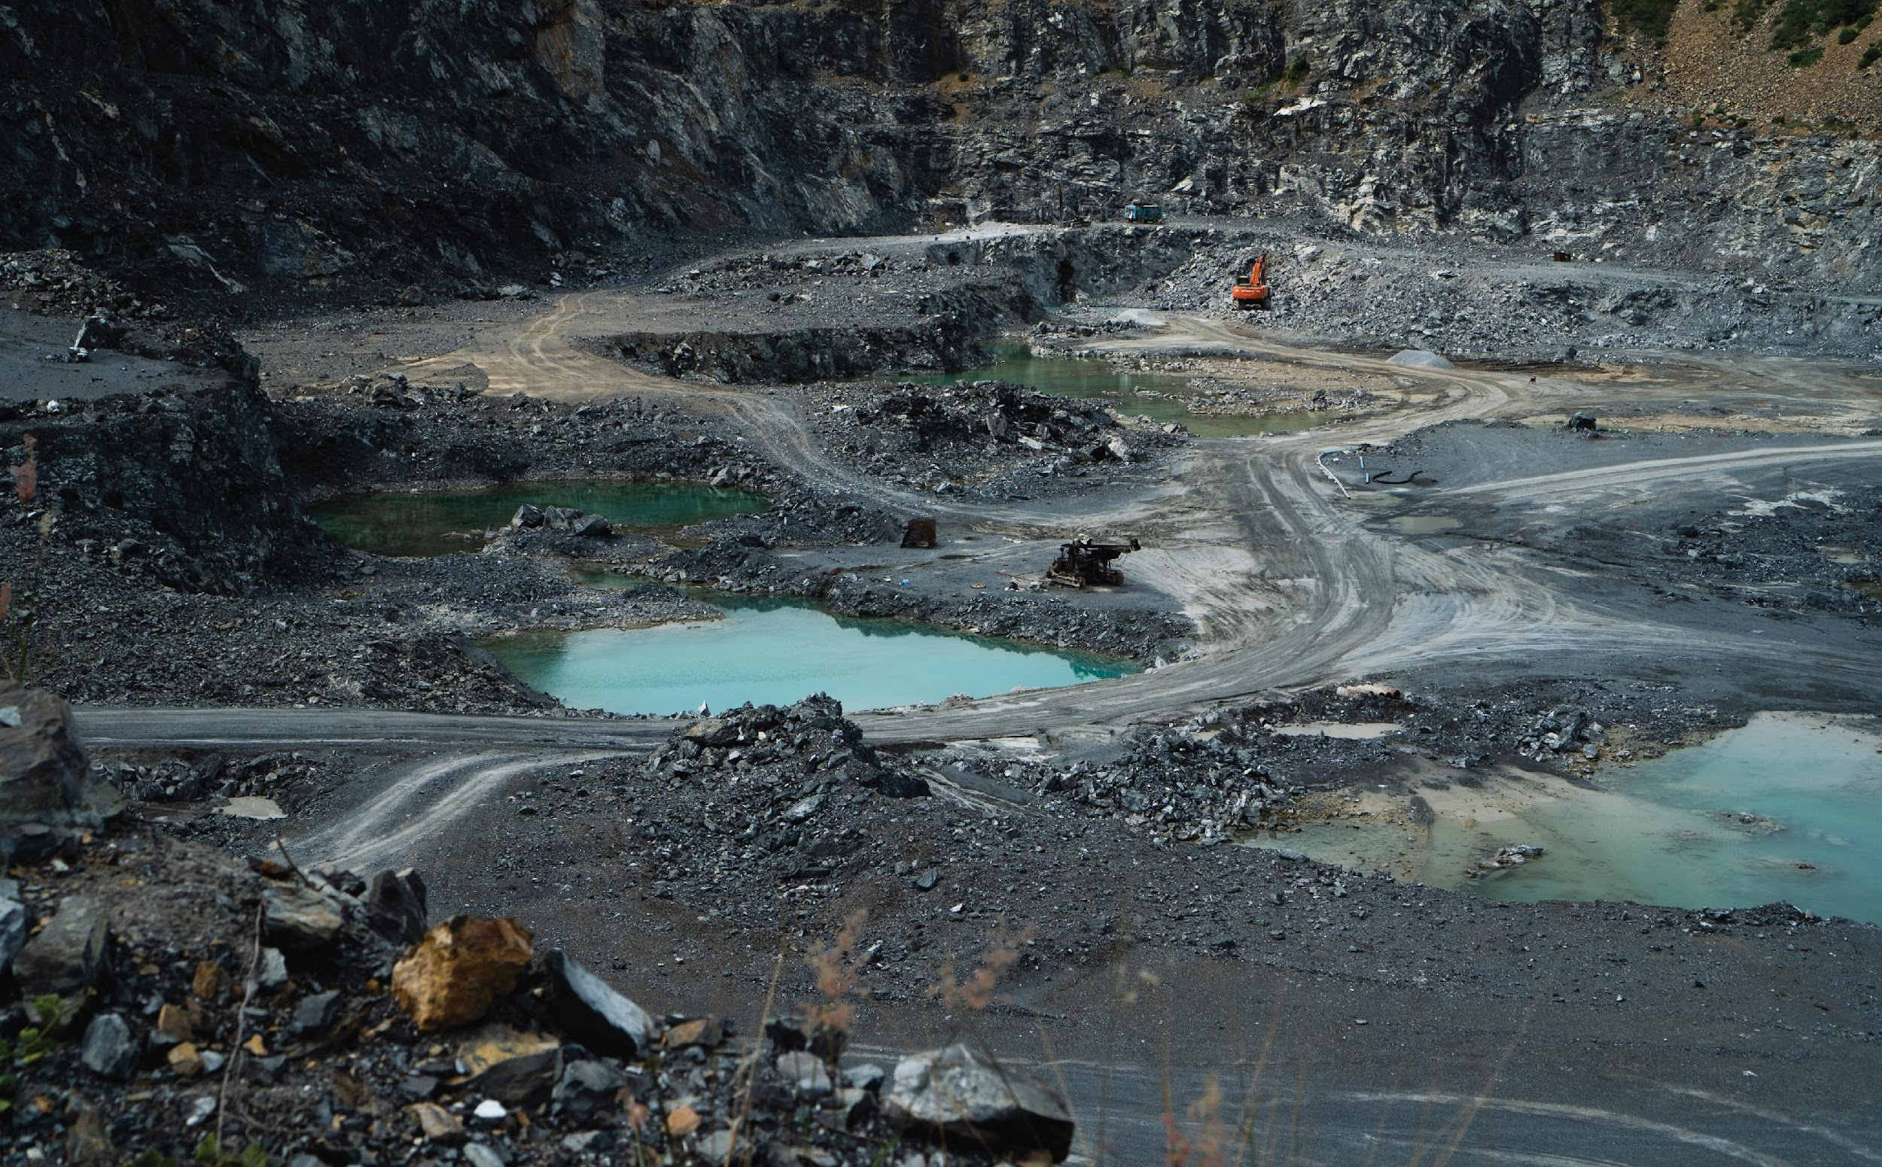
Examples: Successful Industrial Symbiosis Practices

Slide 8
Case study– Boliden: Production and circularity of byproducts from Cu smelting
Several byproducts are extracted during copper smelting
Examples of byproducts are copper sulphate and zinc clinker*
Copper sulphate is obtained in blue crystals and sold as a reagent to the mining industry
Zinc clinker, a product of slag, is a yellow powder that can be used to extract metallic zinc
Cu
INDUSTRIAL SYMBIOSIS CREATED
Copper ores
Aggregates
Construction
RAW MATERIALS
PRODUCT
Ashes & dust
Cu smelting and refining
Zn clinker
Zn
Raw materials
Products
Consumable products
BY- PRODUCTS & CIRCULARITY
E-material
Cu sulphate
Reagent mining
Waste, landfilled
WASTE GENERATION AVOIDED
Source: https://www.boliden.com/operations/products/byproducts/
* Other byproducts included in the study are sulphuric acid, precious metals, lead, tin and nickel sulphate.

Slide 9
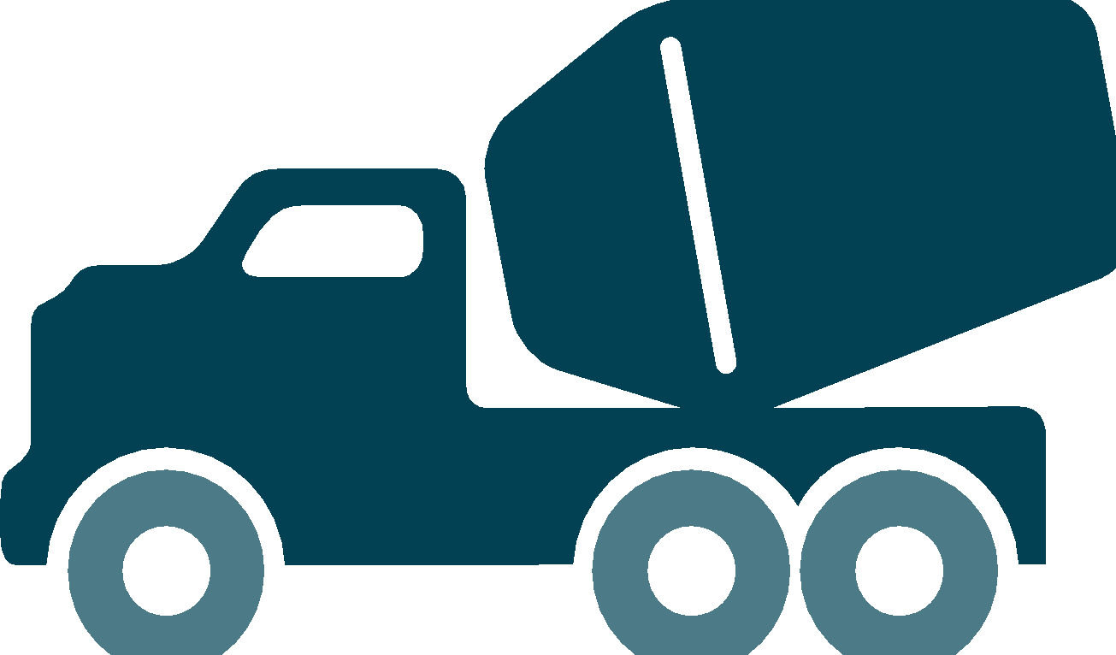
Iron silicate industrial symbiosis
Iron silicate is an unavoidable Cu byproduct and similar to natural minerals from quarries
Two tonnes of iron silicate are generated per tonne of copper produced
Use of iron silicate generates environmental, economic and social benefits. According to a study Aurubis conducted at their facilities, each year:
11,400 t CO₂-eq can be saved if iron silicate is used as an aggregate in road construction
170,000 t CO₂-eq can be saved if iron silicate is used as a reactive mineral additive in blended cements
116,000 t CO₂-eq can be saved if iron silicate is used as a substitute for cement in concrete
Baseline: one million tonne of gravel (100 percent substitution)
Baseline: one million tonne of cement (20 percent substitution)
Baseline: one million tonne of concrete (20 percent substitution of cement and 100 percent substitution of crushed stone)

Slide 10
Iron silicate from Cu production—replacement of natural aggregate in concrete production
Concrete production uses rocks extracted from quarries as aggregate material
Both activities (storing Cu slag and extracting aggregates) have adverse environmental impacts
Extraction from quarries linked to adverse social impacts
Storing Cu slag is a burden for smelters
Cu slag (like Iron silicate) has suitable mechanical properties for several uses

Slide 11
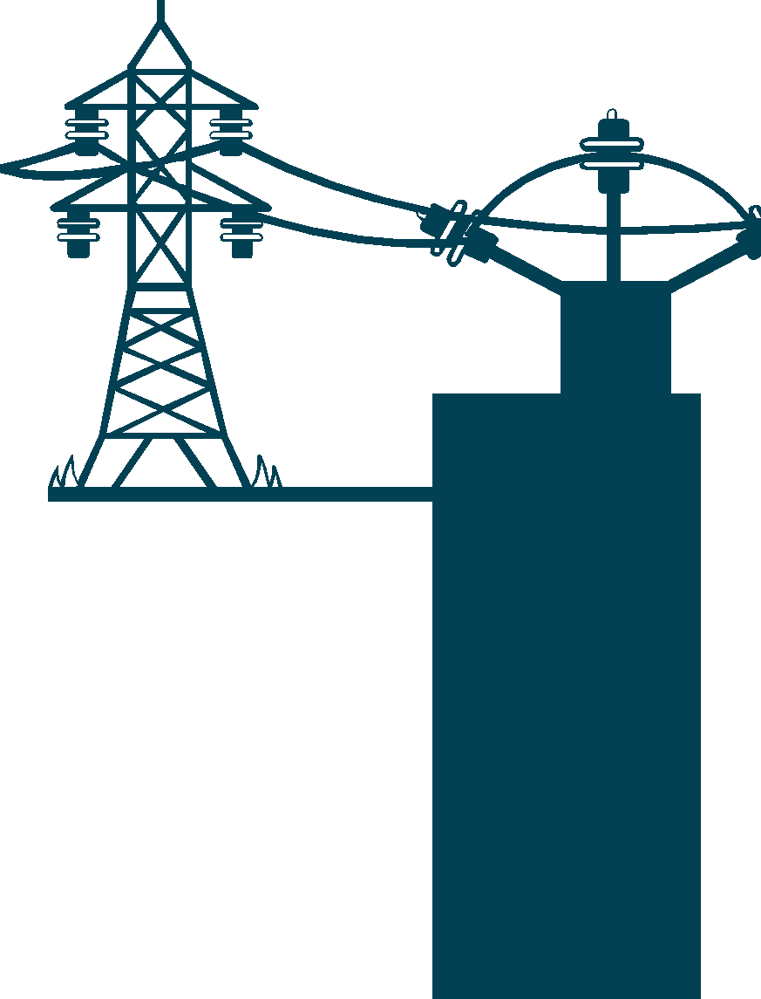
Example: Repurposing EV batteries
EoL EV batteries have economic value and can be repurposed for second-life applications after reaching 80 percent capacity, thus extending the value of copper
This indirectly increases the use of re-purposed copper in other sectors
Cu
Electric vehicles
EoL EV battery
RESOURCE
Cu
WASTE
Second life in other sectors (energy storage, etc.)
EoL SECOND LIFE
Recycling

Slide 12
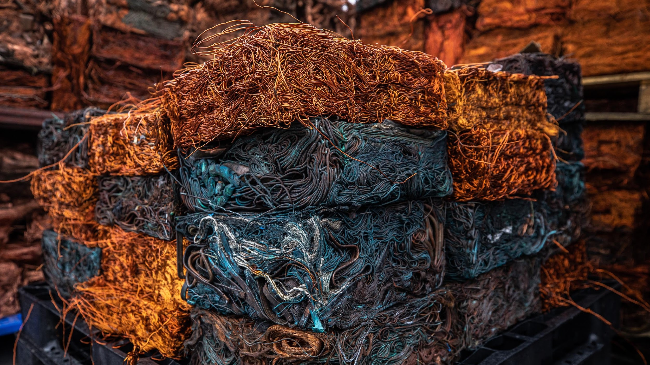
Discussion & Next Steps

