Slide 1
Copper’s Contribution to Universal Energy Access
John R. Mollet
6 Sept 2012

Slide 2
Presentation Structure
Section 1: A global perspective on slum and rural electrification
Section 2: The Sao Paulo, Brazil project
Section 3: Societal benefits

Slide 3
Slums
1 billion people in urban / peri-urban slums
1/3d of world urban population
Many in megacities
Growing @ 5% per annum
No or inadequate access to electricity
Low quality installations
Unaffordable, sometimes theft of power
Unsafe (injuries, death, fires..)
Waste of energy
Notes:
According UN Habitat, one billion people or one out of three people living in cities of the developing world live in a slum, also known as shanty town, favela…. The highest percentage is in sub-Saharan Africa, where 62 percent of the region’s urban population lives in a slum.
More than half the world’s population now lives in cities. Each week, an average of three million people in the developing world move to a city. By 2050, global urbanisation levels are expected to reach 70 percent. As a result, the global slum population grows at 5% per year.
Cities are a crucial element of reducing carbon emissions and sustainable use of resources. Because they generate a disproportionate share of a nation’s GDP, cities generally have higher levels of energy consumption than non-urban areas.
Many of the world’s coastal cities will be affected by climate change. Rising sea levels are threatening the 3,351 cities in the low elevation coastal zone, which houses 10 percent of the world’s population and 13 percent of its urban population
Slums are identified as illegal settlements and I will offer a definition later on.
Even is the slum population has access to electricity, often the services are of low quality, unreliable, unsafe and because wire and cable is not according to the codes, energy is wasted.

Slide 4
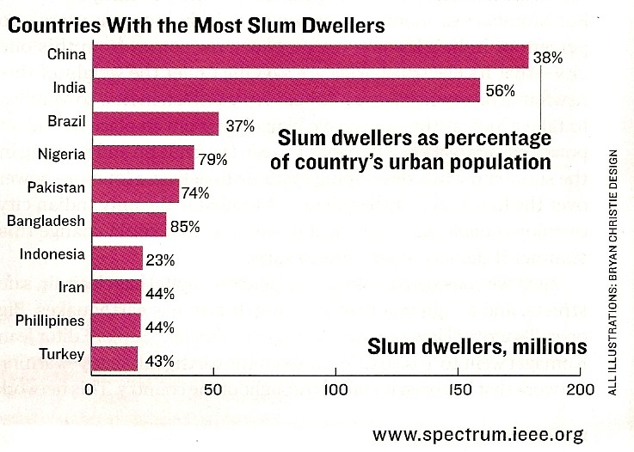
Background
Notes:
While most of us probably pick India with the highest slum population, the number of slum dwellers in China would be even higher, according to this chart.
Brazil ranks third, and we will describe one of our most successful projects in the second part of this presentation.
It is interesting to note that ¾’s or more of the urban population in Nigeria, Pakistan and Bangladesh live in slums.

Slide 5
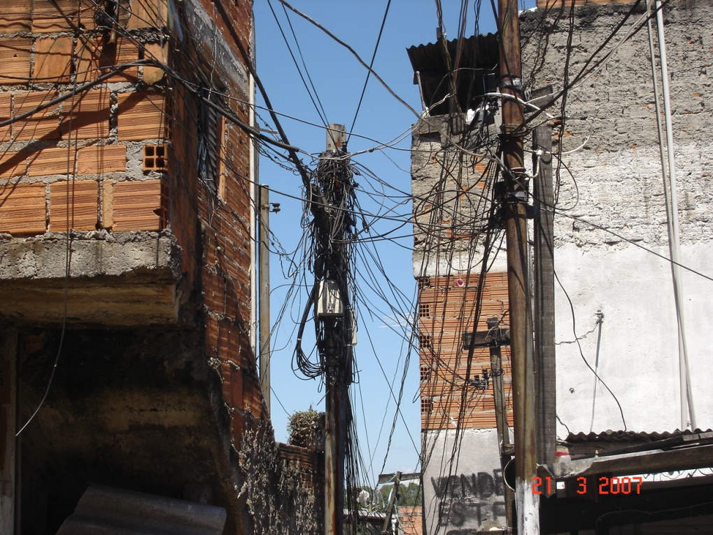
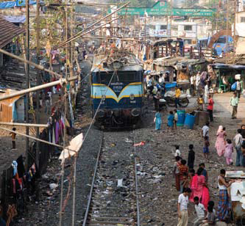
Background
Mumbai
Sao Paulo
| The Societal Benefits of Copper _World Electrification webinar_6 Sept 2012
Notes:
UN Experts’ definition:
slum is an area that combines to various extents the following characteristics:
• Inadequate access to safe water;
• Inadequate access to sanitation and other infrastructure such as modern electricity services ;
• Poor structural quality of housing;
• Overcrowding; and
• Insecure residential status.
However, slums are economically useful as providing low-income housing to people seeking economic development through jobs in cities.

Slide 6
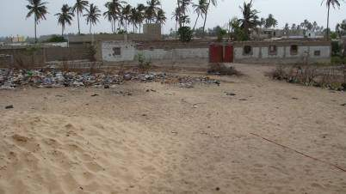
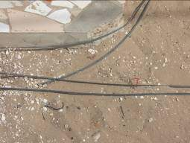
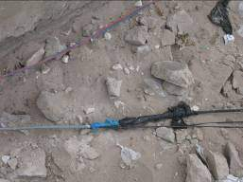
Background
Pikene, Dakar, Senegal
Undersized connections
Dangerous connections
Notes:
Not all live in the densely populated city areas, but also in the suburbs or peri-urban areas. An example is the Pikene neighborhood of Dakar, Senegal.
ECI works there with the government and the consumer organization and noted that distribution of power coming from a utility pole is done by amateurs to connect illegal housing. These cables are way undersized and connections are un-professional, i.e. very dangerous, especially in wet conditions. Children have been noticed to play in the dirt and get their hands burned by touching these cables.
Also, one person with a legally connected home, may connect the next neighbors and charge these easily 3 times more than what he or she pays the utility. There is no stealing from the utility as is the case in many areas such as in Brazil’s favelas, making the case for utility involvement more difficult, but energy comes at a high cost and is still just as unsafe.

Slide 7
Improving the slums
Supply side
Power distribution network – correct sizing of cables, energy efficiency of transformers
Street lighting
Demand side
Rewiring of homes for safety and efficiency
Energy efficiency of appliances and lighting
Clean, renewable energy, e.g. solar water heating
Notes:
When improving electricity services in low-income urban areas, lessons learned from past efforts, including the Brazilian project I will describe in more detail, a comprehensive approach is the best avenue towards a successful income.
The electric utility should address both the supply side, i.e. the distribution of power all the way from the transformers to connection to the consumer; as well as the demand on power inside the buildings.
Safety, power quality and reliability, and energy efficiency are part of the equation.

Slide 8
Who cares?
Community based organizations
Electric utilities
Local and national governments
Development agencies
United Nations
World Bank
Regional Development Banks
Foundations, inter alia

Slide 9
Case for Action
Community satisfaction, Quality of life
Sense of citizenship
Affordable energy
Improved safety
Access to quality electrification can create enterprises & jobs

Slide 10
Rural
1.3 billion people without electricity (ref: IEA)
Almost 20% of world population
Some in cities, most in rural villages of Africa and Asia
Electricity required
Economic development & poverty alleviation
Healthcare
Education….
Notes:
The United Nations General Assembly has declared 2012 as the Year of “Sustainable Energy for All” (SE4A) to start addressing this huge need. The UN Secretary General, with advice from a public-private panel of high-level experts, has set three long-term goals: (i) universal access to electricity by 2030, (ii) doubling the rate of energy efficiency improvements, and (iii) expand the use of clean renewable energy.
Most of the technical solutions to address these goals involve “copper” as an enabler of access to electricity, energy efficiency and renewable energy technologies.
The lack of adequate access to safe, reliable electricity services creates numerous hardships for people throughout the world, mostly the poor, also known as the bottom of the pyramid.
Notably health care facilities are severely compromised in the delivery of primary health care services. Any energy sources such as kerosene for lighting are typically much more expensive. Opportunities for economic development are almost non-existent.. Many indoor cooking methods are polluting and a health hazard. Some 1.6 million women and children die annually from smoke inhalation.

Slide 11
Rural
Notes:
In many countries, it is uneconomical or unpractical to expect the utilities to bring power to rural villages. It is up to the locals to work with providers and financers of distributed generation to bring off-grid electricity to their communities.
Not only to have light and to be able to charge mobile phones, but to run irrigation pumps, power small. let’s say micro. businesses, install computers in schools, etc.

Slide 12
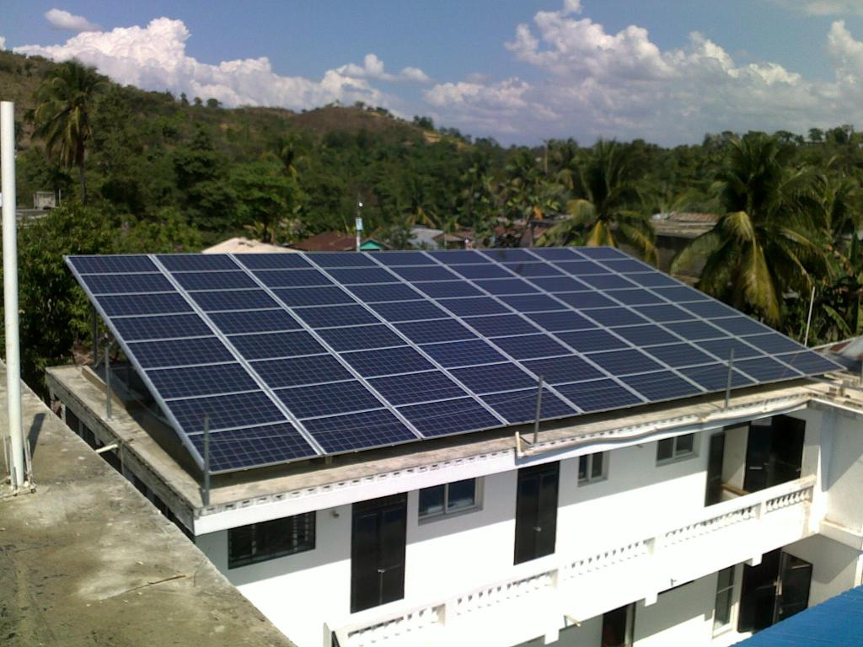
Women’s Clinic Haiti
Notes:
An example of a project: ICA and General Cable joined to support the Solar Electric Light Fund to install solar pv on many clinics and hospitals in Haiti run by Partners in Health, the Boston based organization co-created by Dr. Paul Farmer, professor at Harvard Medical.
ICA helped pay for the installation, while GC, a member of the US CDA and member of the ICF, twice provided free wire and cable to interconnect the solar arrays and to wire the hospitals.
This action will allow the healthcare facilities to run independently from an unreliable electric utility.

Slide 13
Presentation Structure
Section 1: A global perspective on slum and rural electrification
Section 2: The Sao Paulo, Brazil project
Section 3: Societal benefits

Slide 14
Sao Paulo, Brazil
Notes:
Before project implementation in Paraísopolis, the second largest “favela” (poor urban “slum” area) in São Paulo, Brazil, the quality of electricity service was very poor: almost all the households and businesses had illegal electricity connections, were exposed to dangerous network and wiring conditions and did not pay for service. Households and businesses consumed, what are considered for this population, high amounts of electricity – on average 250 kWh/ month – due to the very poor condition of household appliances and electrical equipment (especially refrigerators and electric water heaters used for showers). There was also a lack of price signal to encourage consumers to use electricity wisely.

Slide 15
Partnership
Global Development Alliance
U.S. Agency for International Development (USAID)
International Copper Association (ICA)
Additional Partners
AES Eletropaulo (San Paulo electric utility)
Wire and Cable, Transformer and Refrigerator manufacturers
Community and Community Based organizations
Notes:
Through a Global Development Alliance partnership, the US Agency for International Development and ICA teamed with AES Eletropaulo, the electric utility, to develop, test, and evaluate customized approaches to regularizing electricity service in a selected area of Paraísopolis that covers two neighborhoods (Antônico and Centro). This pilot area included 4,365 low income households and businesses
(of which 60 households had small home businesses and 423 were stand-alone commercial enterprises of varying sizes and types of services/sales).
See slide

Slide 16
Socio-economic conditions
16000 utility customers
Notes:
Like most other favelas, Paraísopolis is an informal community which lacks many municipal services and is home to families that migrated from rural areas over the years. Located in a large ravine, Paraísopolis has a physically challenging geography and is surrounded by middle- and upper-income residential areas. 40% of the adults had only an education up to 4th grade and only some 30% had formal work.
See slide

Slide 17
Pre-project conditions
In-efficient, overloaded transformers
Undersized cables (distribution, drop)
Illegal connections (theft of power)
No public lighting in side streets, alleys, parks
Notes:
To get access to electricity, people hooked into the utility’s wires illegally making the connections look like spaghetti as the video will show.
The wires and cables connecting to the homes and business were undersized, and the utility distribution transformers around the edges of the neighborhood, not being energy efficient to begin with, became so overloaded due to this unplanned and illegal demand, that some even glowed in the dark.
As there was no street lighting, for safety reasons, people installed their own outdoor lighting but then left them on all day.

Slide 18
Pre-project conditions
Broken, bypassed or no electric meters
98% non-paying customers
Unsafe home wiring (fires, electrocutions)
Energy “in-efficiency” of lighting and appliances
Notes:
Survey’s in the Paraisopolis homes and businesses showed appalling indoor conditions, some listed on this slide.
Wiring had been installed without any professional help and many times with cross-sections way too small to meet the demand of electricity. E.g. in some homes, telephone wiring was found rather than heavier gauge electrical copper wiring that meets or exceeds building codes.
Refrigerators were old, totally in-efficient wasting a lot of energy. Also, many households had no idea that leaving the door open or using broken seals dramatically raised their power consumption. Of course, most didn’t care since they were not paying for it anyway.

Slide 19
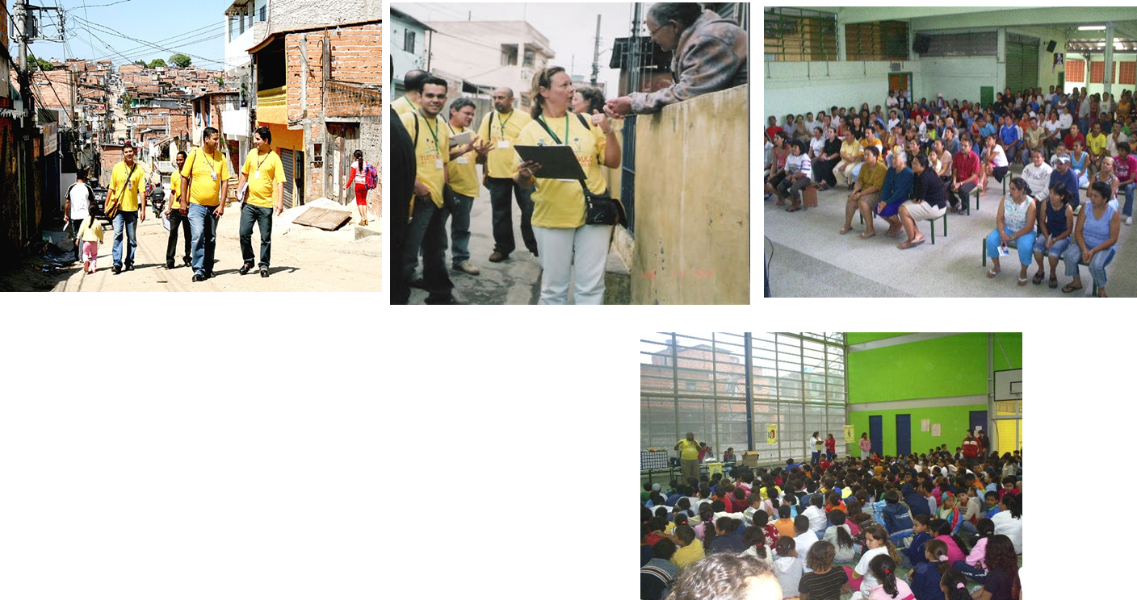
Community involvement
Pre- and post-project awareness campaigns
Providing legal addresses, opening access to credit
Lectures at schools
Job training & search
Notes:
It became clear, also from past failed attempts to address the conditions and to regularize the power distribution, that a new approach was warranted.
It was not just a technical and a legal issue.
It had to become a socio-economic project.
Talking to but more importantly listening to the people to understand their needs and concerns. In short, a different form of customer service. Education about safety and energy efficiency. Providing street names and house numbers. Helping with job training. Giving assistance with obtaining credit at the banks, once customers could prove they actually paid bills.
All in all, besides working with community leaders, fifteen community campaigns were carried out over several months, supplemented by door-to-door visits by community “agents” and by utility staff to each household both pre- and post- regularization.

Slide 20
Video
Overview of continuing electrification projects by Copper AllianceTM partner, AES Eletropaulo, Sao Paulo, Brazil

Slide 21
Upgrading Distribution Network
Energy efficient distribution transformers
Bi-coaxial drop cables(anti-theft)
Public lighting
Metering
Quality distribution cables
Notes:
Households were not charged a connection fee and any debts owed were forgiven. A key component of the program was the use of new technologies and techniques to reduce theft as well as improve the energy efficiency and reliability of the network. These upgrades included:
• Using bi-coaxial copper cable in the new service drop to each individual meter.
• Introducing and installing electronic metering for large commercial consumers to allow easy disconnect in the case of non-payment.
Replacing conventional and overloaded distribution transformers with energy efficient transformers which used copper winding wire.
505 public street lights not only contributed to reducing energy consumption in the neighborhood, but provided a better sense of security.

Slide 22
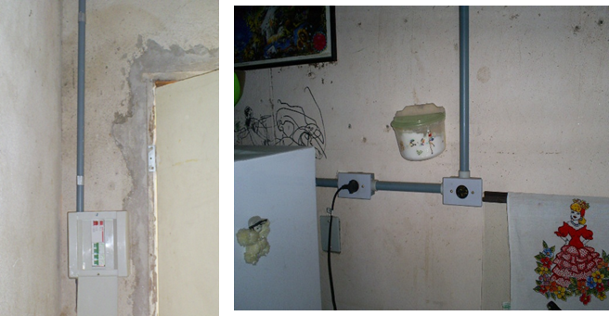
Improving quality of life
Rewiring
above code to meet current & future demand
– e.g. 2.5mm2 circuit
6mm2 drop cable
improve safety
reduce energy losses
Before
After
Notes:
Actions to reduce the consumption at the customers included:
•496 houses in extremely poor condition were rewired to better-than-code sized wiring to allow for future, higher loads (in residences, e.g. copper cross-sections of 2.5mm2 for supply, 4mm2 for the electric water heaters). This saved on average 11kWh/month, but mainly guaranteed safety. This may not seem that much but it is a significant amount for low-income families.

Slide 23
Energy efficiency
Replacement of incandescent lamps for compact fluorescent lamps
Saved 17 kWh / month / lamp
Power average of the incandescent lamps: 70 W
Power average of the CFL lamps: 23 W
Time average of the lamps: 12 hours / day
Notes:
Replacement of incandescent lamps, ranging from 40 to 200W, with Compact Fluorescent Lights (CFL)

Slide 24
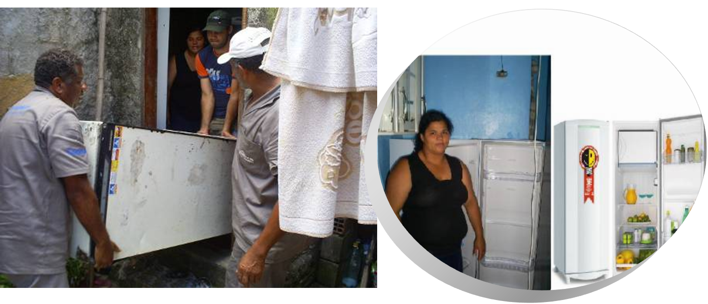
Replacement of refrigerators
New refrigerators with eco-friendly cooling gas
All metallic materials recycled and CFC or HCFC incinerated
Savings of 46 kWh / month per field survey
Notes:
Replacement of old high power consuming refrigerators to high energy efficiency models, among the poorest households. The old models consumed as much as 100 to 150kWh/month. The replacements met the highest energy efficiency label based on the Procel standard, the Brazilian national electricity conservation program. They use copper wire in the compressor. The average measured savings were 48kWh/month/customer. Old refrigerators were removed for eco-friendly recycling.

Slide 25
Replacement of electric shower with solar water heating (where possible)
Save on average 46 kWh / month / house
Use of solar heating 65% of the time
Installation of energy use metering
Notes:
Where possible, costly electric water heating has been replaced or complimented by solar water heating, a technology also reliant on copper.

Slide 26
Outcomes
$2 Million successful pilot project (2006-2007)
Continued investment at rate of US$ 30 million per year by AES Eletropaulo
servicing homes and small businesses
Energy savings up to 50% per household
from 200-300 down to 100-200 kWh/month
Brazil government supports replacement old refrigerators with EE models
More than 90% paying customers
Satisfaction with: customer services, safety, affordability, obtaining legal address, access to micro-credit, job training = FULL CITIZENSHIP
Notes:
The success as viewed by both the community and the utility led to a massive replication, reaching to-date some 450,000 connected homes and businesses in the state of Sao Paulo.
The unique partnership created to develop and implement the pilot project could serve as a model for other communities, not just in Brazil, but throughout the world. Not only AES Eletropaulo but other Brazilian utilities continue programs to properly electrify low-income urban and per-urban areas, reducing technical and commercial losses, and bringing safety, reliability and sense of citizenship to the communities.
See slide

Slide 27
Presentation Structure
Section 1: A global perspective on slum and rural electrification
Section 2: The Sao Paulo, Brazil project
Section 3: Societal benefits

Slide 28
Societal Benefits of Access to Sustainable Energy
Safer living conditions
Energy efficiency and clean energy can reduce carbon and other emissions
Positive impact on:
Climate change mitigation
Human health
Healthcare cost
3. Economic benefits
To individuals, businesses, economies
Job creation
Notes:
In conclusion, providing modern, copper-based, access to energy offers a range of societal benefits:
•Safer living conditions
•Economic development that benefits individuals, businesses and economies
•Energy efficiency and clean energy reduce any carbon and other emissions flowing from power generation, yielding a positive impact on human health and healthcare costs

Slide 29
Societal Benefits
Energy Efficiency of Access System
Saved energy in one community can become available to another community without power
More affordable energy
Resource conservation
Energy security
Participation in society as citizens
Notes:
•Energy efficiency allows energy to become more affordable.
Saved energy in one community can allow to power another community when it is grid –connected
•Resource conservation
Energy security
And last but not least, a sense of finally belonging to society as full citizens

Slide 30
Recommended reading
One step to citizenship
ICA/AES publication (2009)
The Fortune at the Bottom of the Pyramid
C. K. Prahalad (2004)
The White Man’s Burden
Prof. William Easterly (2006)
Sustainable Energy For All
Vision Statement BAN Ki-Moon, UN Sec. Gen. (2011)

Slide 31
Thank you
For more information please contact

