Slide 1
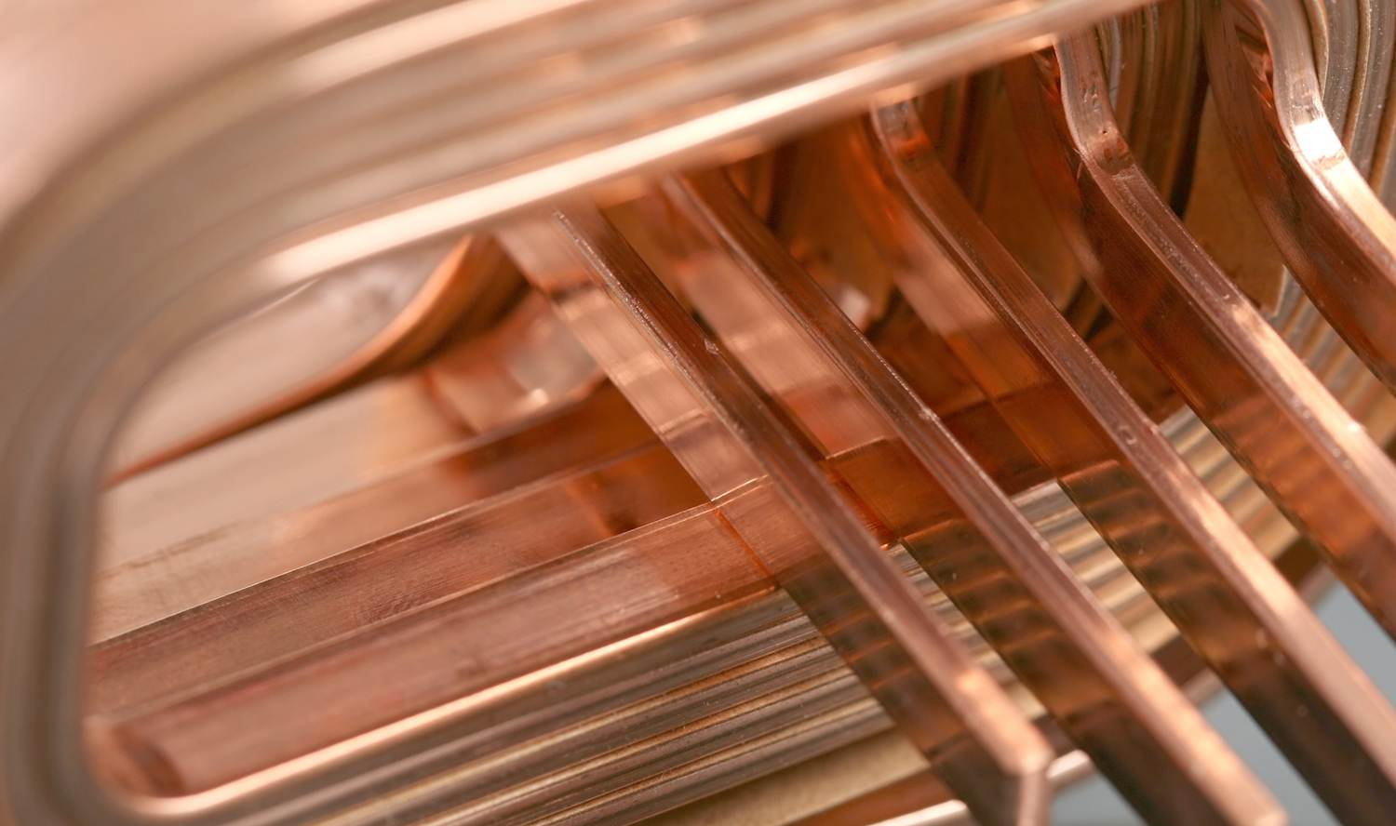
The Societal Benefits of Copper
Innovative copper solutions contribute to energy efficiency and air quality
John Black
27 March 2013

Slide 2
Overview
Introduction: Antimicrobial Copper®
Lab testing copper alloys
Copper’s effect on fungi and bacteria
EPA registration; touch-surfaces and HVAC components
Improved air quality in buildings with copper coils
Improved air quality in public vehicles with copper coils
Reduced maintenance and improved efficiency
Long-term effectiveness of all-copper vs. copper tube/aluminum fin heat exchangers
Market opportunities for copper HVAC components

Slide 3

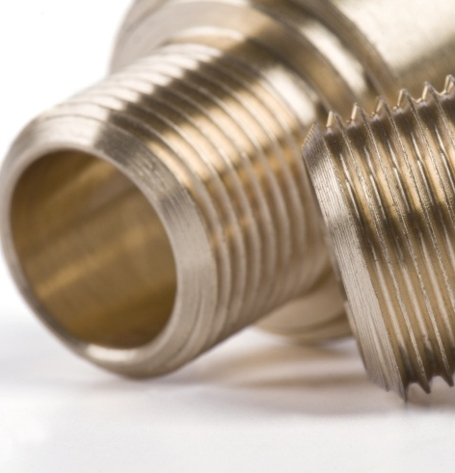
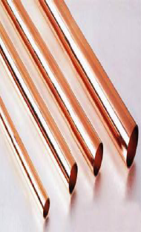
What is Antimicrobial Copper®?
  Antimicrobial copper is not a coating or a surface treatment.
  Antimicrobial copper is a solid copper-based alloy, including brass and bronze.
  Can be bent, formed, welded, cast, stamped, etc.
  Copper alloys have antimicrobial properties that kill microorganisms on contact and prevent growth of bacteria and fungi.

Slide 4
What is Antimicrobial Copper®?
(cont.)
  The health care industry has started using copper touch-surfaces (bed rails, countertops, sinks, etc.) to combat hospital acquired infections (HAIs)

Slide 5
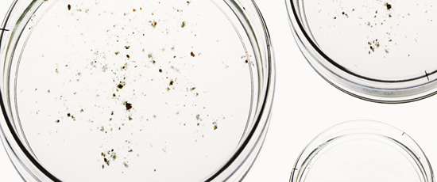
Lab testing copper alloys for antimicrobial properties
  Metal coupons are inoculated with bacteria and fungi.
  Coupons are subjected to a controlled environment for a period of time.
  Cultures are grown and an in situ viability assay is used to determine survival and growth of bacteria and spores.

Slide 6
EPA registration; copper touch-surface products
  Copper’s effectiveness has been proven in rigorous studies that led to EPA registration of 355 alloys as antimicrobial products with health claims.
  Antimicrobial Copper® touch surface products can claim to kill 99.9% of disease causing bacteria within two hours*.
  Copper is the first class of solid surfaces to obtain this form of registration.
*Antimicrobial Copper is the only touch surface material to have efficacy data independently verified through the US Environmental Protection Agency (EPA) registration which supports the claim to continuously kill more than 99.9% of the bacteria that cause HCAIs within two hours of contact. Organisms tested are MRSA, Staphylococcus aureus, Enterobacter aerogenes, Pseudomonas aeruginosa, E. coli O157:H7 and Vancomycin-resistant Enterococcus faecalis.

Slide 7
EPA registration; copper touch-surface products (cont.)
  EPA registration of copper alloys paves the way for fabricators to legally market the health benefits of their copper products for touch surfaces (only).
  Antimicrobial Copper® products can only be sold by registered manufacturers using registered copper alloys.
  Companies wishing to produce, package, label or sell products that make health claims must:
    File their own federal registrations with the EPA, and
    File state registrations for every state in which they or their customers intend to promote Antimicrobial Copper products.

Slide 8
EPA “treated article exemption” registration for copper HVAC components
  For copper alloys used in HVAC applications, the U.S. EPA granted a “treated article exemption” registration.
  This registration allows copper HVAC components to make product protection claims by suppressing the growth of bacteria and molds that reduce system efficiency and cause product deterioration or foul odors.
  These claims are supported by EPA registration 82012-7.

Slide 9
Results of lab and field studies conducted by ICA
Conducted both laboratory tests and field studies on the biofilm buildup of fungi and bacteria on the surfaces of air-conditioner/heat-exchanger components using copper and aluminum (U.S. and China) ^{(1,4,5)}
Measured air quality in terms of indoor levels of fungi and bacteria in buildings (U.S.) and in public buses (China) ^{(3,4,5,6,7)}
Studied the long-term effects of mold growth and thermal cycling on the energy-efficiency performance of copper and aluminum fin-and-tube heat exchangers (China) ⁽⁸⁾

Slide 10
Copper’s effect on fungi (mold)
  Fungal species associated with aircon systems
  Most fungal species show a total die off after 24 hours exposure to copper, including Candida albicans, Fusarium oxysporium, Fusarium solani and Penicillium chrysogenum.
  Aspirgillus species are more resistant, requiring longer periods of exposure before total die off.
  Aspirgillus niger is the only fungus tested that shows no die off after significant periods of exposure to copper. However, copper has been shown to inhibit the growth of A. niger spores and prevent A. niger from colonizing on a copper surface. Aluminum had no effect on A. niger.⁽¹⁾

Slide 11
Copper’s effect on aspirgillus
Aspergillus niger spores after seven days exposure to C11000 copper (left) and aluminum (right). No germination of spores on copper coupons, positive germination on aluminum ⁽¹⁾
Aspergillus flavus after four days exposure on copper (left) and aluminum (right).
Aspergillus fumigatus after four days exposure on copper (left) and aluminum (right).

Slide 12
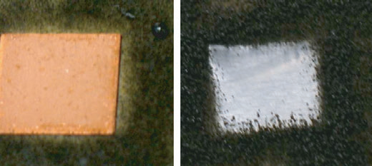
Copper’s effect on aspirgillus (cont.)
These photos show the inhibition of Aspergillus niger on copper and aluminum after ten days. Spore suspensions of A. niger were spread over plates, and coupons of copper and aluminum were placed on the surface. Plates were incubated for ten days at 22ºC. Growth occurred onto the aluminum coupon whereas growth was inhibited surrounding the copper coupon. ⁽¹⁾

Slide 13
Copper’s effect on bacteria
  Antimicrobial Copper® continuously kills bacteria, even when tarnished … copper’s effect never wears off (EPA registrations 85012, 1 - 6) ⁽²⁾
  The EPA officially acknowledges copper’s efficacy against these disease-causing bacteria:
    Escherichia coli (O157:H7): a food-borne pathogen
    Methicillin-Resistant Staphylococcus aureus (MRSA): a virulent antibiotic-resistant bacteria that threatens healthcare environments
    Staphylococcus aureus: results in potentially life-threatening infections including pneumonia and meningitis
    Vancomycin-Resistant Enterococcus faecalis (VRE): antibiotic-resistant and responsible for 4% of all HAIs
    Enterobacter aerogenus: often results in skin infections
    Pseudomonas aeruginosa: infects immune-compromised patients

Slide 14
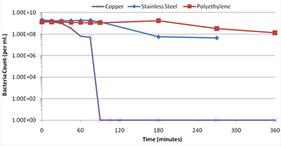
Copper’s effect on E. coli
Viability of E. coli 0157:H7 on Copper, Stainless Steel and Polyethylene Surfaces
Source: http://antimicrobialcopper.com/us/scientific-proof/registration-against-bacteria/e-coli.aspx

Slide 15
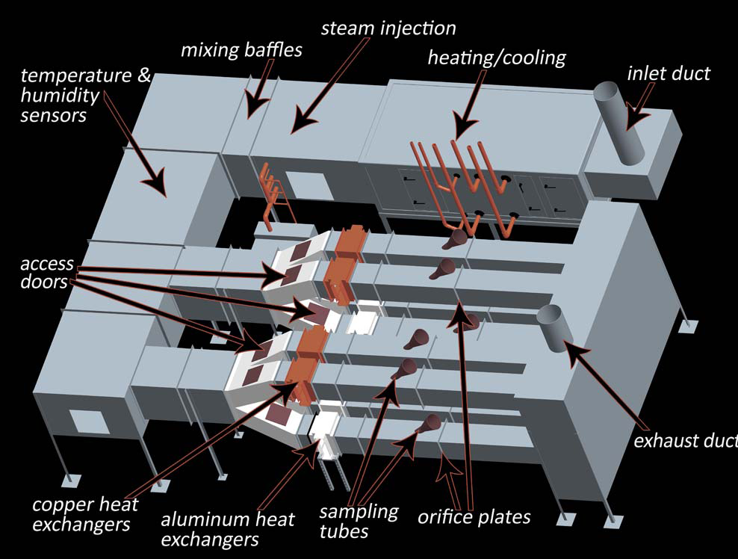
Improved air quality in buildings with copper HVAC components
  The “Copper Air Quality Program” for Dept. of Defense
  Field study monitored indoor levels of bacteria and fungi (Ft. Jackson, SC)
  Lab study monitored biofilm buildup using coupons on heat exchangers (USC)
Laboratory HVAC system installed at the University of South Carolina ^{(3, 4, 5)}

Slide 16
Improved air quality in buildings with copper HVAC components—lab results
  Lab testing showed that over a 30-week period, biofilm buildup on aluminum heat exchanger coupons was three to four orders of magnitude greater than on the copper heat exchangers:⁽⁴⁾
    Average bacteria concentration from aluminum coupons: 11,411 cfu/ cm²
    Average bacteria concentration from copper coupons: 1 cfu/ cm²
    Average fungi concentration from aluminum coupons: 378 cfu/ cm²
    Average fungi concentration from copper coupons: 3 cfu/ cm²
  The extent to which copper limited the growth of bacteria was 99.9%, and the limitation of fungal growth was 99.74% of that observed on the control, aluminum-based heat exchangers.

Slide 17
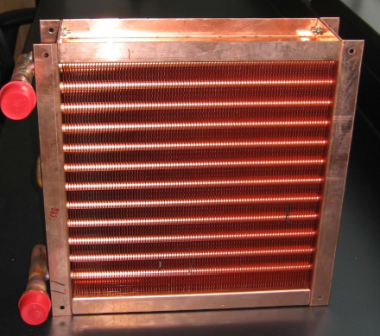
Improved air quality in buildings with copper HVAC components—field results
  Air conditioned by copper heat exchanger assemblies was found to have significantly lower airborne fungal concentrations when measured at the ambient breathing zone as well as adjacent to the discharge air vent, compared to aluminum assemblies, in both heating and cooling seasons. ⁽³⁾
Fungi CFU per m³
All-copper heat exchanger
Heating season
Cooling season

Slide 18
Public bus air quality effects of using copper heat exchangers
  A study of public buses was performed in China for the antimicrobial effect of copper on cabin air quality. ^{(6,7)}
  15 buses were equipped with all copper evaporators and 10 buses with aluminum evaporators.
  Test samples were taken from outside air, the AC air supply, breathing zones in the cabin and the fin surface of the evaporator. Monitoring included temperature, humidity, barometric pressure, respirable particulate matter, total number of bacteria and total number of fungi.

Slide 19
Public bus air quality effects of using copper heat exchangers (cont.)
  Compared to aluminum, copper exhibits significant antimicrobial effects on bacteria and fungi that come in contact with the metal surface.
  Aluminum coil surfaces have been seen to have up to 10x the fungi levels and 60x the bacteria levels compared to copper coils.
  The microbial level on the surface of the AC coils with aluminum fins will increase significantly along with the use of the system. Research showed the aluminum coil did not comply with local standards by the end of the testing period.
  Copper coils lowered the total number of bacteria and mold in cabin air compared to aluminum coils, but the phenomena could not be shown when monitoring the vent outlet air from the AC units. Further testing is required for confirmation.

Slide 20
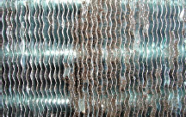
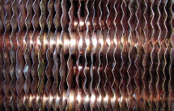
Long-term effects of mold growth and thermal cycling on HVAC energy efficiency performance
    A liquid suspension of Aspirgillus niger mold spores uniformly applied to the surface of evaporators. ⁽⁸⁾
    Spore-coated heat exchangers were incubated in a greenhouse at controlled conditions for 28 days.
    With similar spore treatments, no noticeable mold growth was observed on the copper coils, but mold growth on the aluminum-fin coils covered up to 60% of the surface.
Mold-treated aluminum coil—rated grade 3, mold area ratio = 60%
Mold-treated copper coil—rated grade 0, mold area ratio = 0%

Slide 21
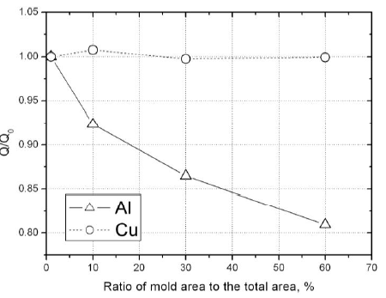
Long-term effects of mold growth on HVAC energy- efficiency performance
  Effects of mold area on heat flow rate: as the ratio of mold area to total area increases to 60%, the heat flow rate of aluminum coils decreases by 19% while copper coils are virtually unchanged. ⁽⁸⁾
This graph shows the normalized heat flows of aluminum coils and copper coils versus the ratio of mold areas to total area: 0%, 10%, 30% and 60%.

Slide 22
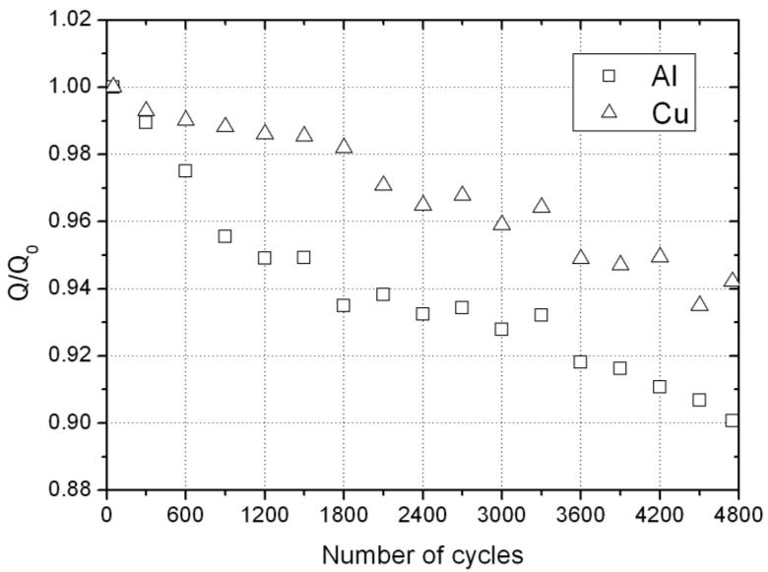
Long-term effects thermal cycling on HVAC energy efficiency performance
Effects of thermal cycling: at 4,800 cycles aluminum coils decreased to 90.1% vs. copper coils at 94.2% of the original heat flow rate.
Cu
94.2%
  This graph shows the effects of thermal cycling on the long-term performance of fin-and-tube heat exchangers (normalized heat flow to number of cooling/heating cycles for aluminum coils and copper coils).
Al
90.1%
Note that 4,800 cycles is equivalent to four years service life.⁽¹⁾

Slide 23
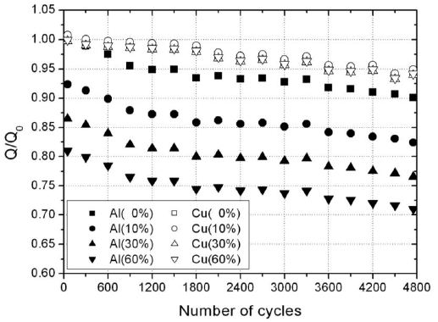
Long-term effects of mold growth and thermal cycling on HVAC energy-efficiency performance (cont.)
  Effects of thermal cycling and mold area: after 4,800 cycles the greatest capacity loss rate for copper coils is 5.8% whereas for aluminum coils it is 27%, 3.7X that of copper.⁽⁸⁾
Cu
-5.7%
This graph shows the nor-malized heat flow to number of cooling/heating cycles for aluminum coils and copper coils with mold areas 0%, 10%, 30% and 60%.
Al
-27%
Note that 4,800 cycles is equivalent to four years service life.⁽¹⁾

Slide 24
Long-term effects of mold growth and thermal cycling on HVAC energy-efficiency performance (cont.)
    Due to normal thermal cycling of heat exchangers not treated with mold, after 4,800 thermal cycles the copper coil had deteriorated to 94.2% of original heat flow and the aluminum-fin coil to 90.1%.
    Mold-treated copper coils exhibited no mold growth and showed no performance deterioration from mold.
    Mold-treated aluminum coils exhibited considerable mold growth of up to 60% of the frontal area and showed a 19% deterioration in heat flow rate performance.
    Combining mold growth and normal deterioration from thermal cycling, aluminum-fin coils have the greatest potential for capacity loss—after 4,800 cycles (four-year equivalent):
      The greatest capacity loss rate for copper coils is 5.8%
      For aluminum coils it is 27%, 3.7 times greater than all-copper coils ⁽⁸⁾

Slide 25
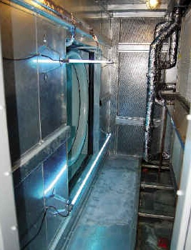
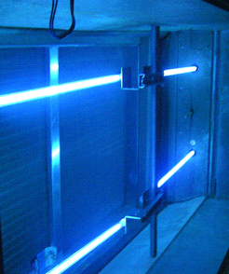
Market opportunities for Antimicrobial Copper® HVAC components
  Health care facilities and public spaces where air quality is a concern, currently use ultraviolet germicidal irradiation (UVGI) to purify air ⁽⁹⁾
UV-C (280 – 100nm) lamps irradiating fan, plenum and cooling coils
Source: Applied Concepts & Technologies Corp. (http://www.actcorp.net/uvgi.htm)
Source: Fresh-Aire UV, div. of Triatomic Environmental (http://www.freshaireuv.com/cs-standard.html)

Slide 26
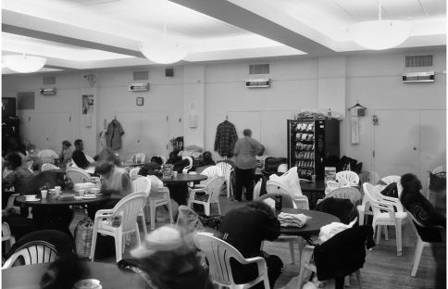
Market opportunities for Antimicrobial Copper® HVAC components (cont.)
  Upper air UVGI units are also common to combat infectious airborne agents ^{(8,9)}
Note UVGI fixtures located on upper wall directly below air vents in this TB shelter in New York City⁽⁸⁾.

Slide 27
Market opportunities for Antimicrobial Copper® HVAC components (cont.)
  Antimicrobial Copper HVAC coils have the potential to replace UVGI units.
    Copper is a more effective antimicrobial agent than UV-C light.
    UVGI units have maintenance issues:
      Burn-in time for new UV lamps
      Dust blocks UV light and reduces effectiveness
      UV lamps become weak after prolonged use
      Difficult to determine when a UV lamp is no longer effective
  Development and testing is required to prove the cost effectiveness of copper HVAC components.
  Commercial companies are willing to partner with the Copper Alliance™ to study and promote copper HVAC components.

Slide 28
In conclusion
  Copper alloys have antimicrobial properties that kill microorganisms on contact and prevent the growth of bacteria and fungi.
  Copper’s effectiveness has been proven in rigorous EPA testing and, as a result, 355 copper alloys are now registered as public health antimicrobial touch-surface products.
  This registration also allows copper HVAC components to make product protection claims of suppressing the growth of bacteria and molds that reduce system efficiency and cause product deterioration or foul odors.
  Copper HVAC components can prevent the growth of mold and bacteria on surfaces resulting in longer coil life and higher operating efficiencies.
  Copper HVAC coils can reduce airborne contaminants and pathogens resulting in improved indoor air quality.

Slide 29
References
Weaver, L. (2009). Potential for Preventing Spread of Fungi In Air Conditioning Systems Constructed
Using Copper Instead of Aluminum. Letters in Applied Microbiology 50 (2010) 18-23, ISSN 0266-8254
2) Michel, J (2012). Your New Weapon in the Fight Against Hospital-Acquired Infections: Antimicrobial
Copper, webinar presented by Modern Healthcare, Sept. 12, 2012, webinar ID: 883-480-666
3) Michels, H. (2011). Copper Air Quality Program. Annual Report #4 prepared for U.S. Army Medical
Research and Materiel Command, Ft. Detrick, Maryland
4) Schmidt, M. G. (2012). Characterization and Control of the Microbial Community Affiliated with Copper
or Aluminum Heat Exchangers or HVAC Systems. Current Microbiology DOI 10.10007/s00284-012-0137-0
5) Feigley, C. (2011) Copper Heat Exchangers for Improving Indoor Air Quality: Cooling Season at Ft.
Jackson. Paper #919, Proceedings of “Indoor Air 2011”, 12th International Conference on Indoor Air
Quality and Climate held in Austin, TX, June 2011
6) Jiangping, C. (2009). The Application of Copper Fin Evaporator on Bus Air Conditioning System.
Shanghai Jiao Tong University Institute of Refrigeration and Cryogenics report to ICA.
7) Jiangping, C. (2011). Year 2011 Research Report for the Comparative Analysis of Antimicrobial
Capability for Copper and Aluminum Fin Radiators in Air Conditioners of Public Buses,
Shanghai Municipal Center for Disease Control and Prevention, Environmental Health Section,
report to ICA.
44

Slide 30
References (continued)
8) Ding, G.(2007). Comparative Study of the Long-Term Performance of Copper and Aluminum Fin-and-
Tube Heat Exchangers. Report V to ICA
9) Nardell, E. (2008). Safety of Upper-Room Ultraviolet Germicidal Air Disinfection for Room Occupants:
Results from the Tuberculosis Ultraviolet Shelter Study. Public Health Reports 2008 Jan.-Feb: 123(1):
52-60 http://www.ncbi.nlm.nih.gov/pmc/articles/PMC2099326/
10) Kowalski, W. (2011). UVGI for Cooling Coil Disinfection, Air Treatment and Hospital Infection Control.
Report prepared for American Air & Water, Inc. http://www.americanairandwater.com/UV-pdf/UVGI-
Report.pdf
Prepared by: EXEL CONSULTING GROUP
45
Copper HVAC Components, December 2012

Slide 31
Thank you
For more information please contact
john.black@copperalliance.org

